Slide 1


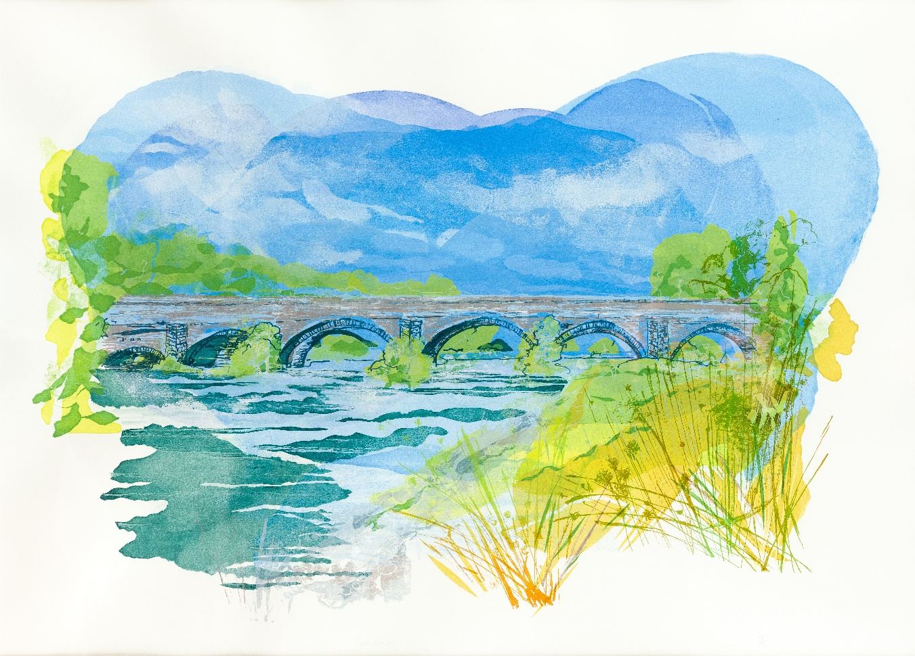
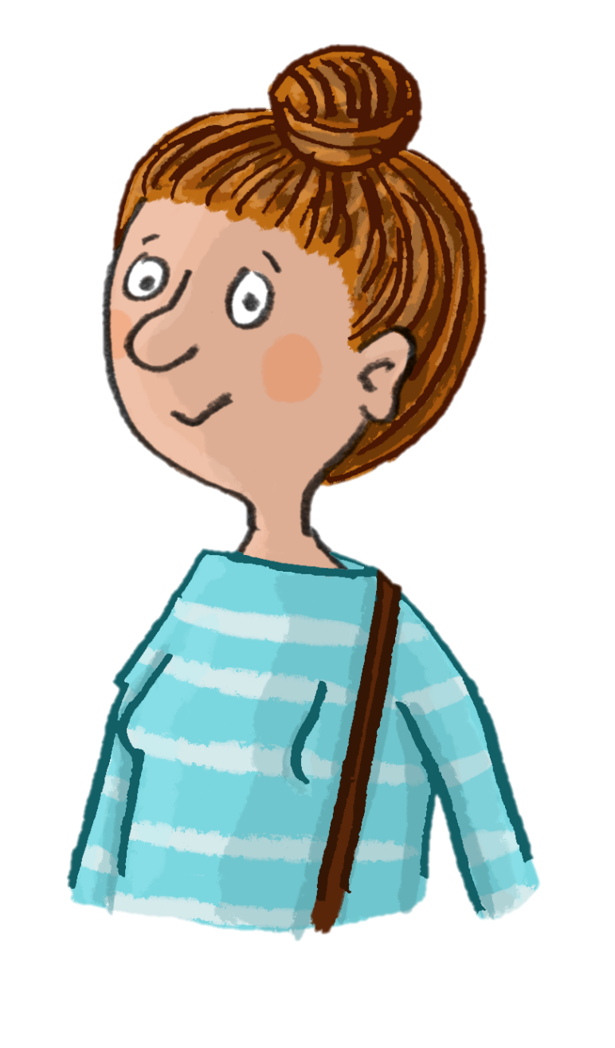
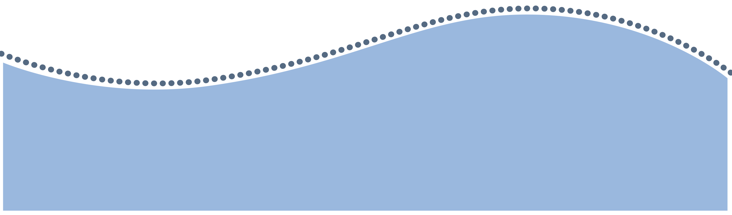

Contemporary Creatives
in the Dee Valley
I’m Sian, a Welsh poet inspired by the Dee Valley.
We often learn about the famous artists and poets from centuries past, but there are plenty of contemporary creatives still taking inspiration from our valley today!

Slide 2

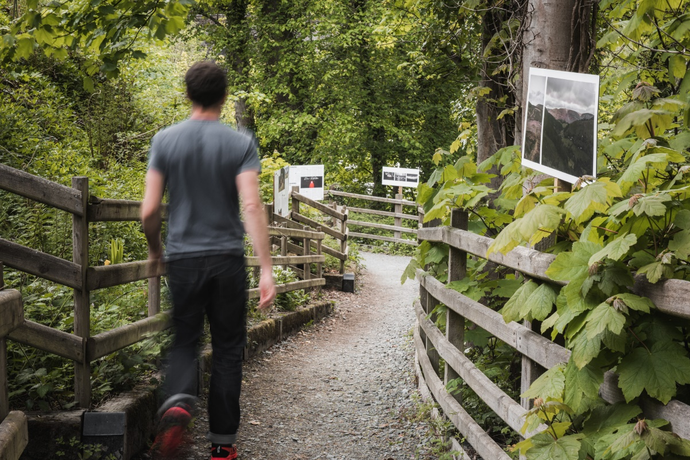
Watch
Dee Valley Artist in Residence
Case Studies
Between 2018 and 2024, creatives were invited by the Our Picturesque Landscape Project to take part in a series of artist residencies, to explore the area and create artwork based on their experiences.
Work was created by a range of artists, poets, writers and makers, following in the footsteps of the creatives who came before them – J.M.W Turner, Richard Wilson, and William Wordsworth to name but a few. They took inspiration from the impressive landscapes of the Dee Valley, and the stories of the remarkable people who have shaped it over time.

Slide 3
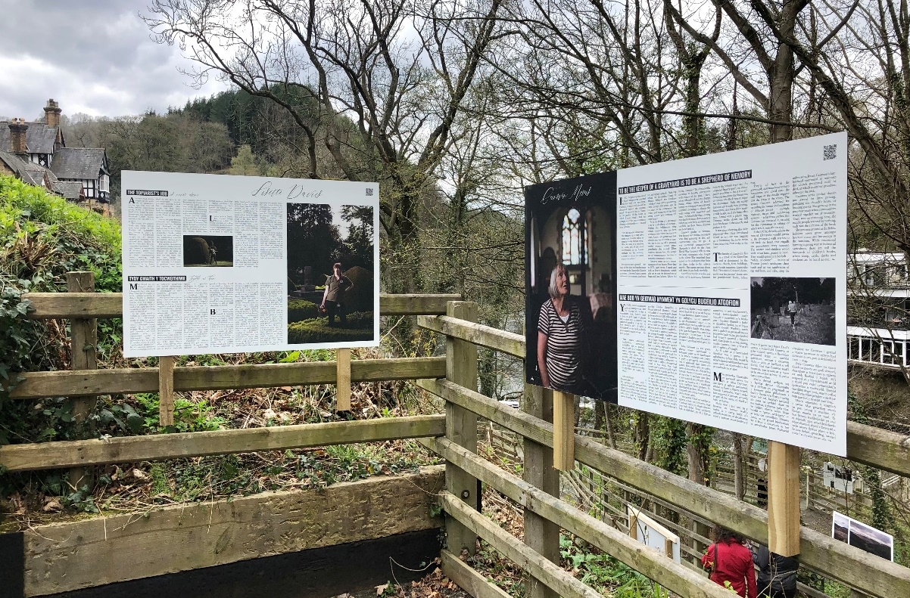
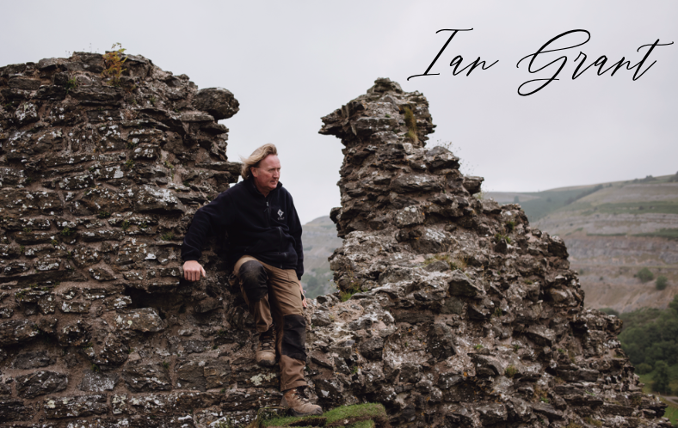
Phil and Jess Hatcher-Moore
Jess and Phil worked collaboratively to interview and photograph people involved in the care and protection of the local heritage and landscape.
Together, they created a collection of written and visual profiles which they exhibited on large-scale exhibition panels, embedded outdoors in the landscape at various locations across the valley.

Slide 4

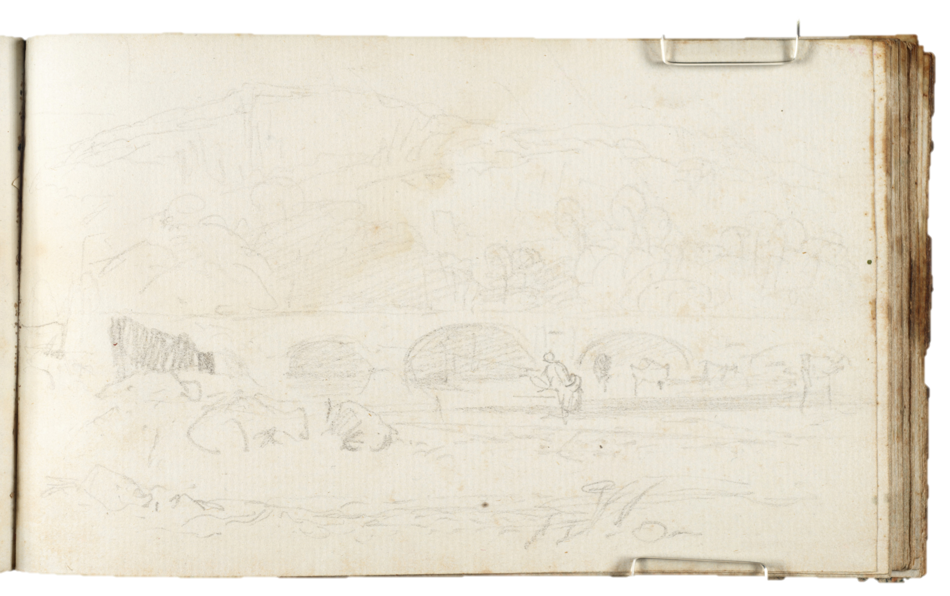
Tara Dean
Tara produced a view of Corwen Bridge, inspired by the location of landscape painter J.M.W. Turner’s ‘The River Dee at Corwen’ in 1808. Created using layer upon layer of screen-printing, the piece is an example of how artists are still captivated by the Picturesque scenes of the Dee Valley to this day.
Sketchbook drawing by J.M.W. Turner
The River Dee at Corwen; Man Fishing and Cattle Watering, 1808,
J.M.W. Turner. Ffoto / Photo: Tate.

Slide 5
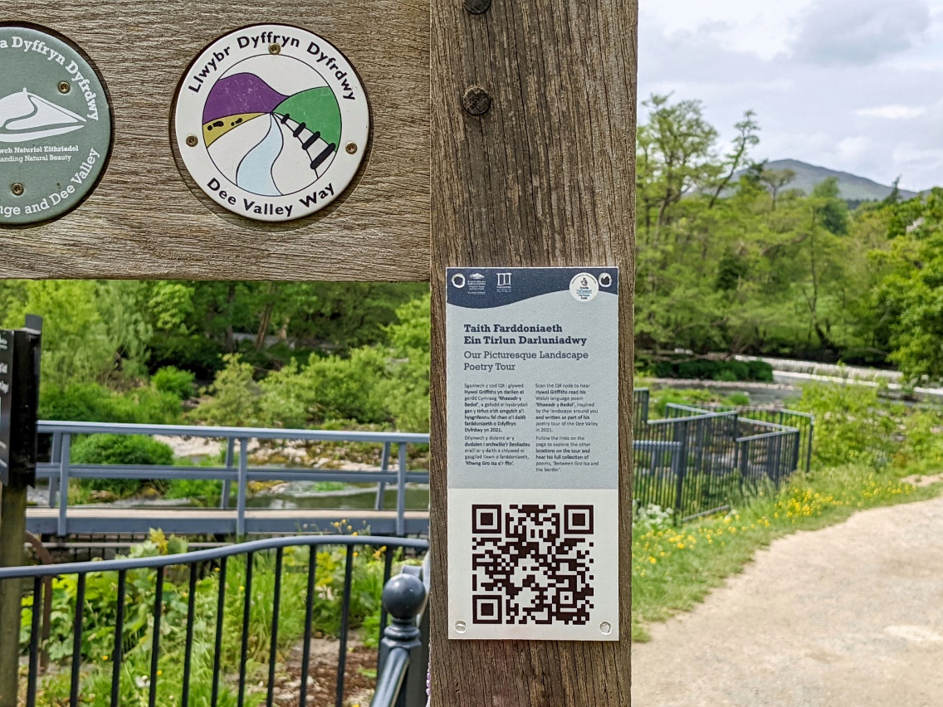
Hywel Griffiths
Listen
Virtual Poetry Tour
Hywel created a virtual poetry tour across six locations in the Dee Valley (Gledrid Bridge, Pontcysllte Aqueduct, Llangollen Bridge, Horseshoe Falls, Glyndyfrdwy, and Gro Isa, Corwen).
The Welsh language poems are inspired by the journey of water through the valley and how it has shaped the landscape. QR codes have been installed at each of the locations for visitors to discover these tours while on site.

Slide 6
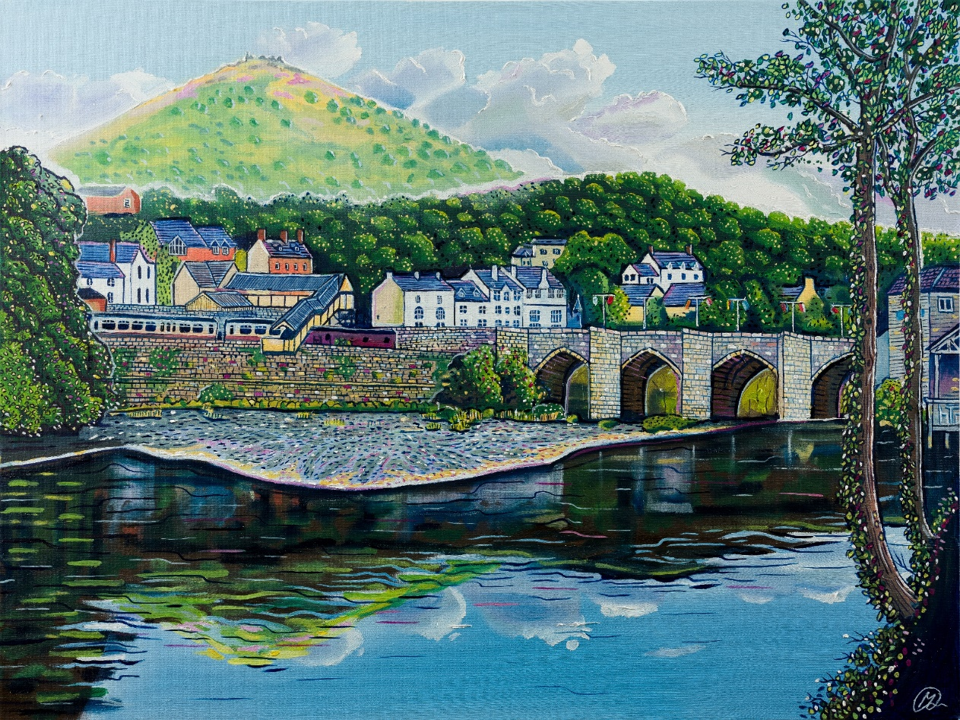
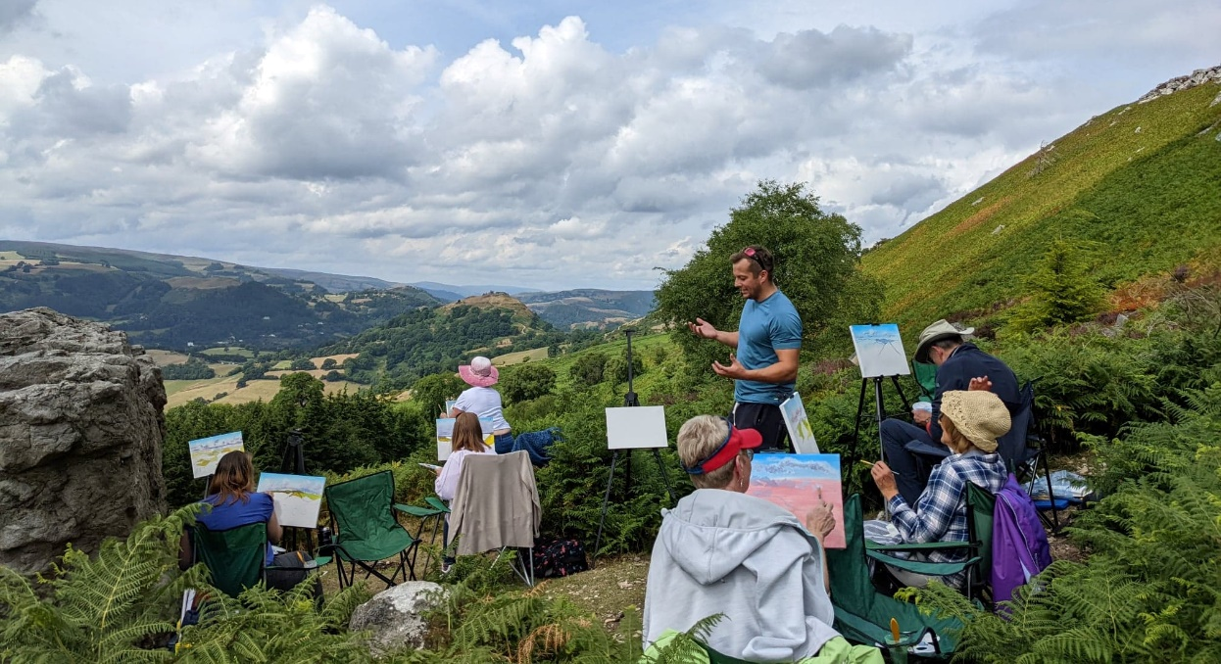
Mikey Jones
Mikey, a local artist from Wrexham, created a modern twist on the iconic scene of Llangollen town and bridge, a nod to the countless artists drawn to the area in search of the sublime. He uses vivid colours and an artistic licence to exaggerate the features of the landscape.
He also ran a series of community painting workshops out in the landscape to share his artistic skills and inspire a new generation of painters.

Slide 7
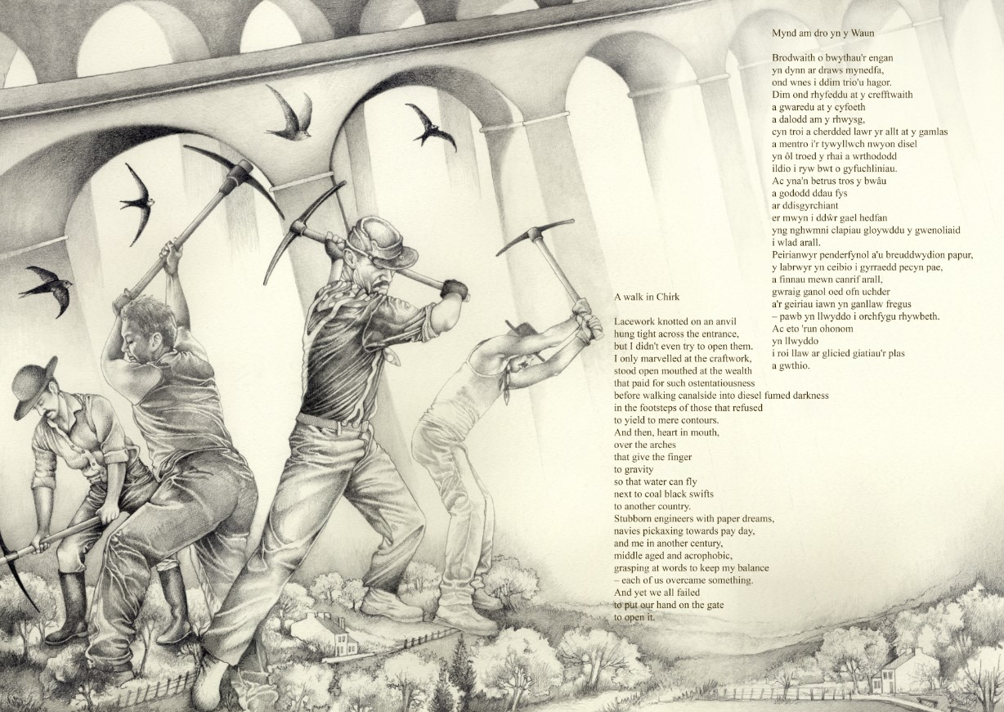
Sian Northey and Bonnie Hawkins
Sian Northey is a poet and author, she writes for children and adults. Sian has written four poems that explore various Dee Valley sites including Chirk, Castell Dinas Brân, Valle Crucis Abbey and Plas Newydd. The poems examine how we use and interact with these special places today, often contrasting her own experiences there, to those who have proceeded us, e.g. monks and navvies.
In response to Sian’s poetry, Bonnie Hawkins hand illustrated Sian’s work, in a series of films that capture the fragility of the landscape in her poetry. The time-lapse films were produced to document the sketching process, accompanied by readings of Sian’s poems.

Slide 8

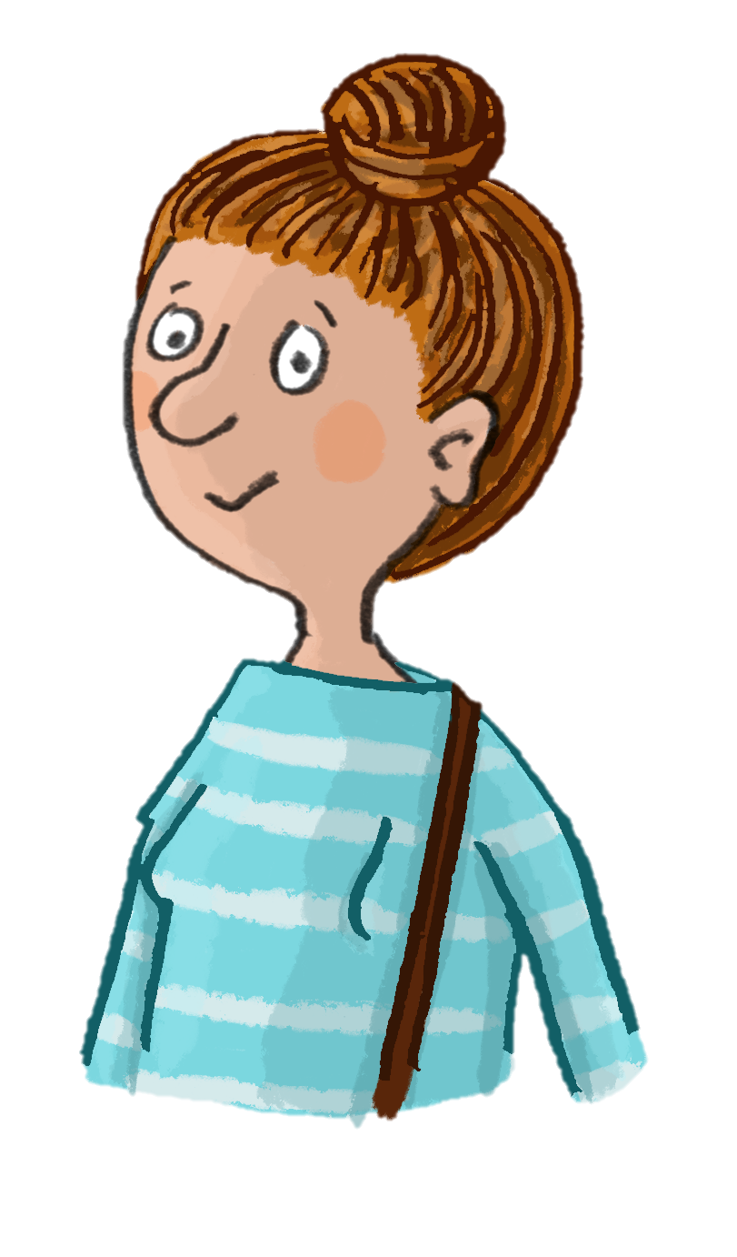
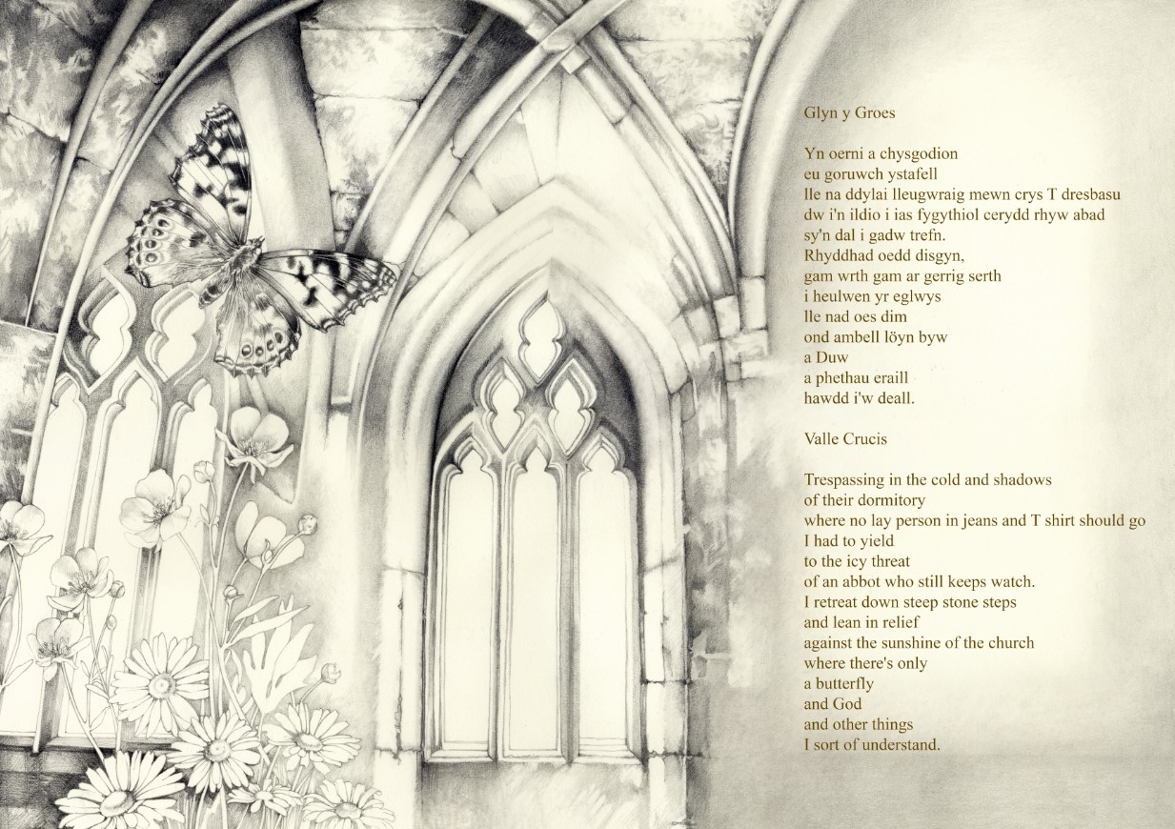
Watch
Task
As a class, listen to Sian’s poems accompanied by the time-lapse illustrations.
How do you think the poet was feeling when they visited Valle Crucis Abbey?
What do you think the poet was thinking about as they crossed the aqueduct at Chirk?
Valle Crucis
A Walk in Chirk

Slide 9
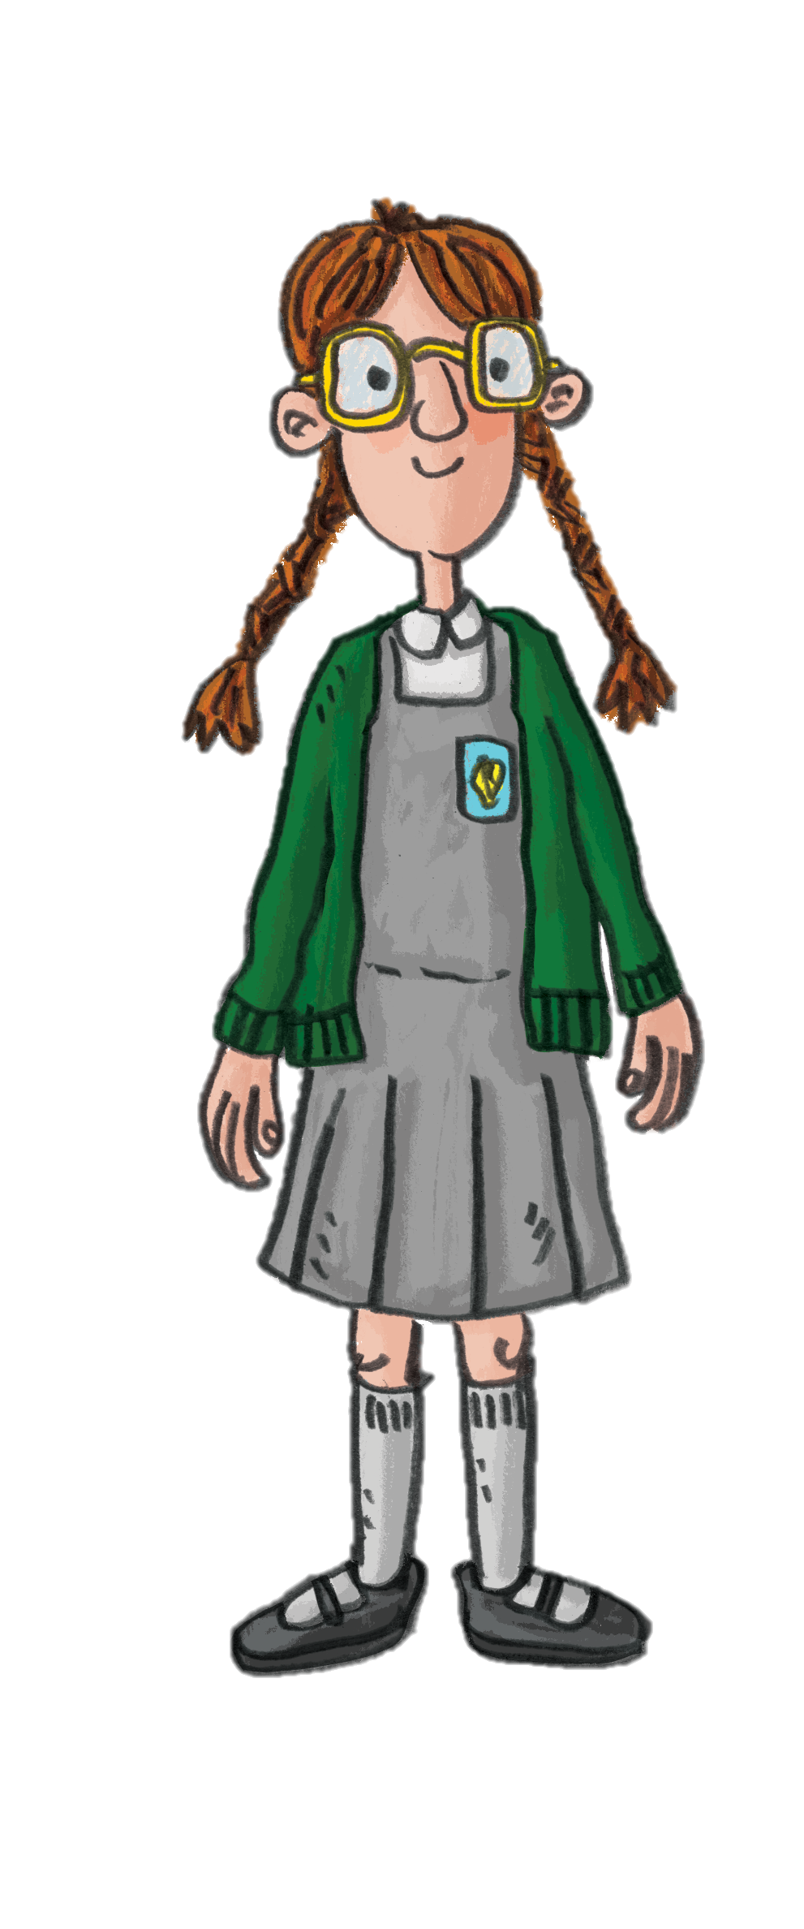
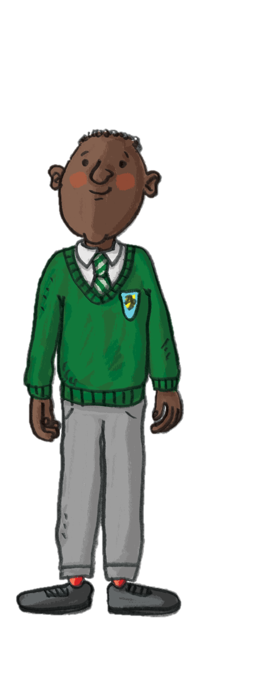


Now let’s take inspiration from Sian and Bonnie to create your own illustrated poem combining your artistic and written skills.
The following activities were developed by Sian Northey.

Slide 10

You will need:
Large piece of paper or whiteboard to write your starter lines
Paper
Pencils
Clipboards
Sit mat
Activity 1:
Poetry Walk
Learning Objective:
I can write a three verse poem about a walk in the countryside.
Success Criteria:
Use the sentence starters to create my poem.
Look at my surroundings for inspiration.
Consider both realistic and imaginative aspects.

Slide 11
Instructions – Poetry Walk
Choose a location to stop on your walk that best suits the activity.
Show the group the sentence starter lines one by one, for example…
I walk up to the…
I see…
Then give them time to complete the line in their own words before giving them the start of the next line
I feel…
And so on for each line.
This is the pattern for the whole poem:
Read their poems in turn and discuss them.
Finally, give everyone an opportunity to choose a title for their poem.
Sentence Starter Lines
I walk up to the…
I see…
I feel… (it can be a physical or mental feeling)
I am… (anything they might want to add)
I walk past the…
I hear…
I imagine…
I am…
I walk along…
I am [anything that actually happened on the walk]
I am [anything completely imaginative]
I reach… [this can be real or imaginative]

Slide 12
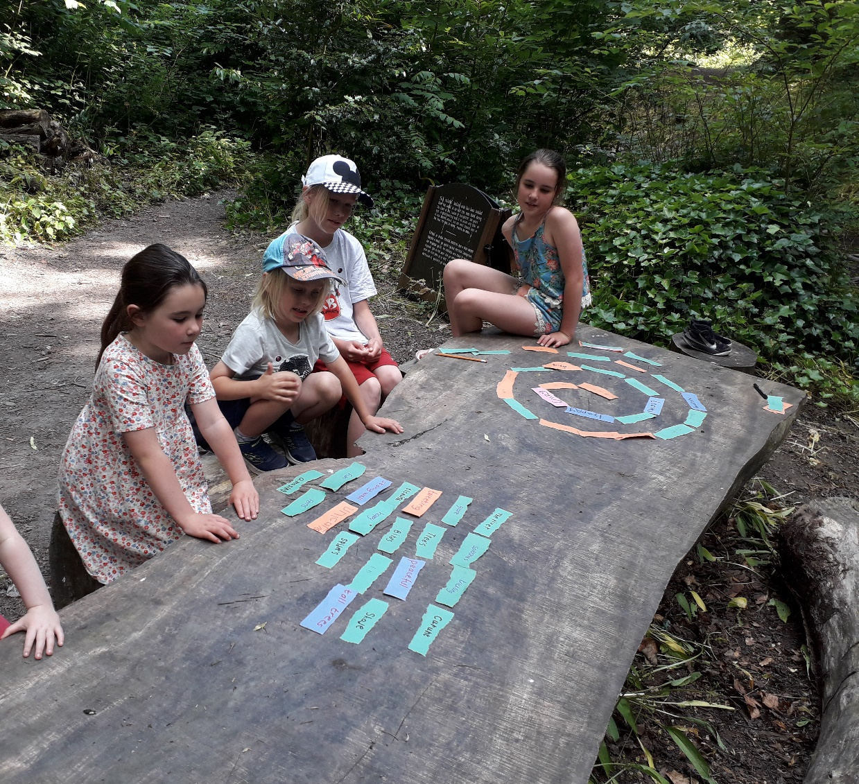
Activity 2:
Somewhere Special
You will need:
Pencils
Scraps of paper
Sit mats

Slide 13
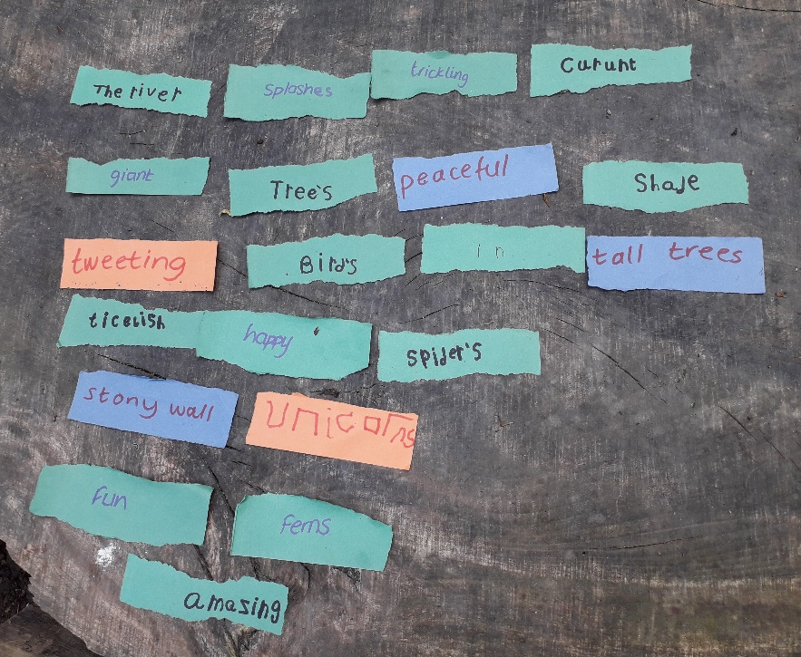
Instructions – Somewhere Special
There are two ways to do this activity:
Each pupil finds a spot to sit quietly and consider the surroundings.
Consider each different sense as you move through the environment.
For each of the following, ask the pupils to write a word or phrase on a different piece of paper for each one;
Close your eyes and when you open them what colours meet you?
Close your eyes and listen, what can you hear?
Breathe deeply – think about the temperature and smell.
Stick your tongue out, like a snake, taste the air.
Feel the ground beneath you, the tree beside you, enjoy the textures, how do they feel?
Word River Poems
In small groups, gather the words and phrases and spread them out to create a winding river shape. They can play with the rhythm of the words by reading them out aloud and adding small connectives to help with the flow of the poem. The poems can be temporary on the ground outside or stuck down onto a long roll of paper.

Slide 14

Activity 3:
Illustrated Poem
Choosing their favourite piece of writing, the pupils can write up their poem for a display and illustrate around it.
You will need:
Pencils / Pens
Paper
Digital video or camera on a tablet or laptop.
Why not create your own stop motion animation or time-lapse film to further develop your poem?

Slide 15
Instructions – Illustrated Poem
Stop Motion
Record each pupil’s voice reading out their poem and use stop motion animation to create a short film. Alternatively, the animation can be created around their poem if their writing is clear.
The following resource created by Natural Resources Wales provides detailed instructions for teachers, with some minor adaptions, as their chosen topic is different, you will be able to create stop motion animations with your class. https://cdn.cyfoethnaturiol.cymru/media/694045/activity-plan-animating-nature.pdf
Time-lapse or sped up video
Use your drawing to create a time lapse or sped up film. Time-lapse video is simply a series of photos so any camera is able to create a time-lapse. You can set your device to capture your desired number of photos per second. Using editing software, you can stitch those photos together to create a time-lapse video.
You can also use the device to record video at a regular speed (30fps, for example) and then use editing software to speed the video up.
In advance, research options online for the devices you have available and practice first, this will help to determine the number of photos to take per second or the speed.

