Slide 1
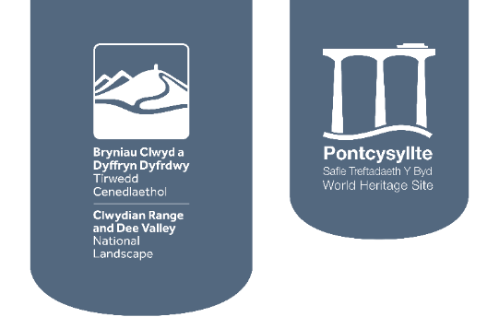
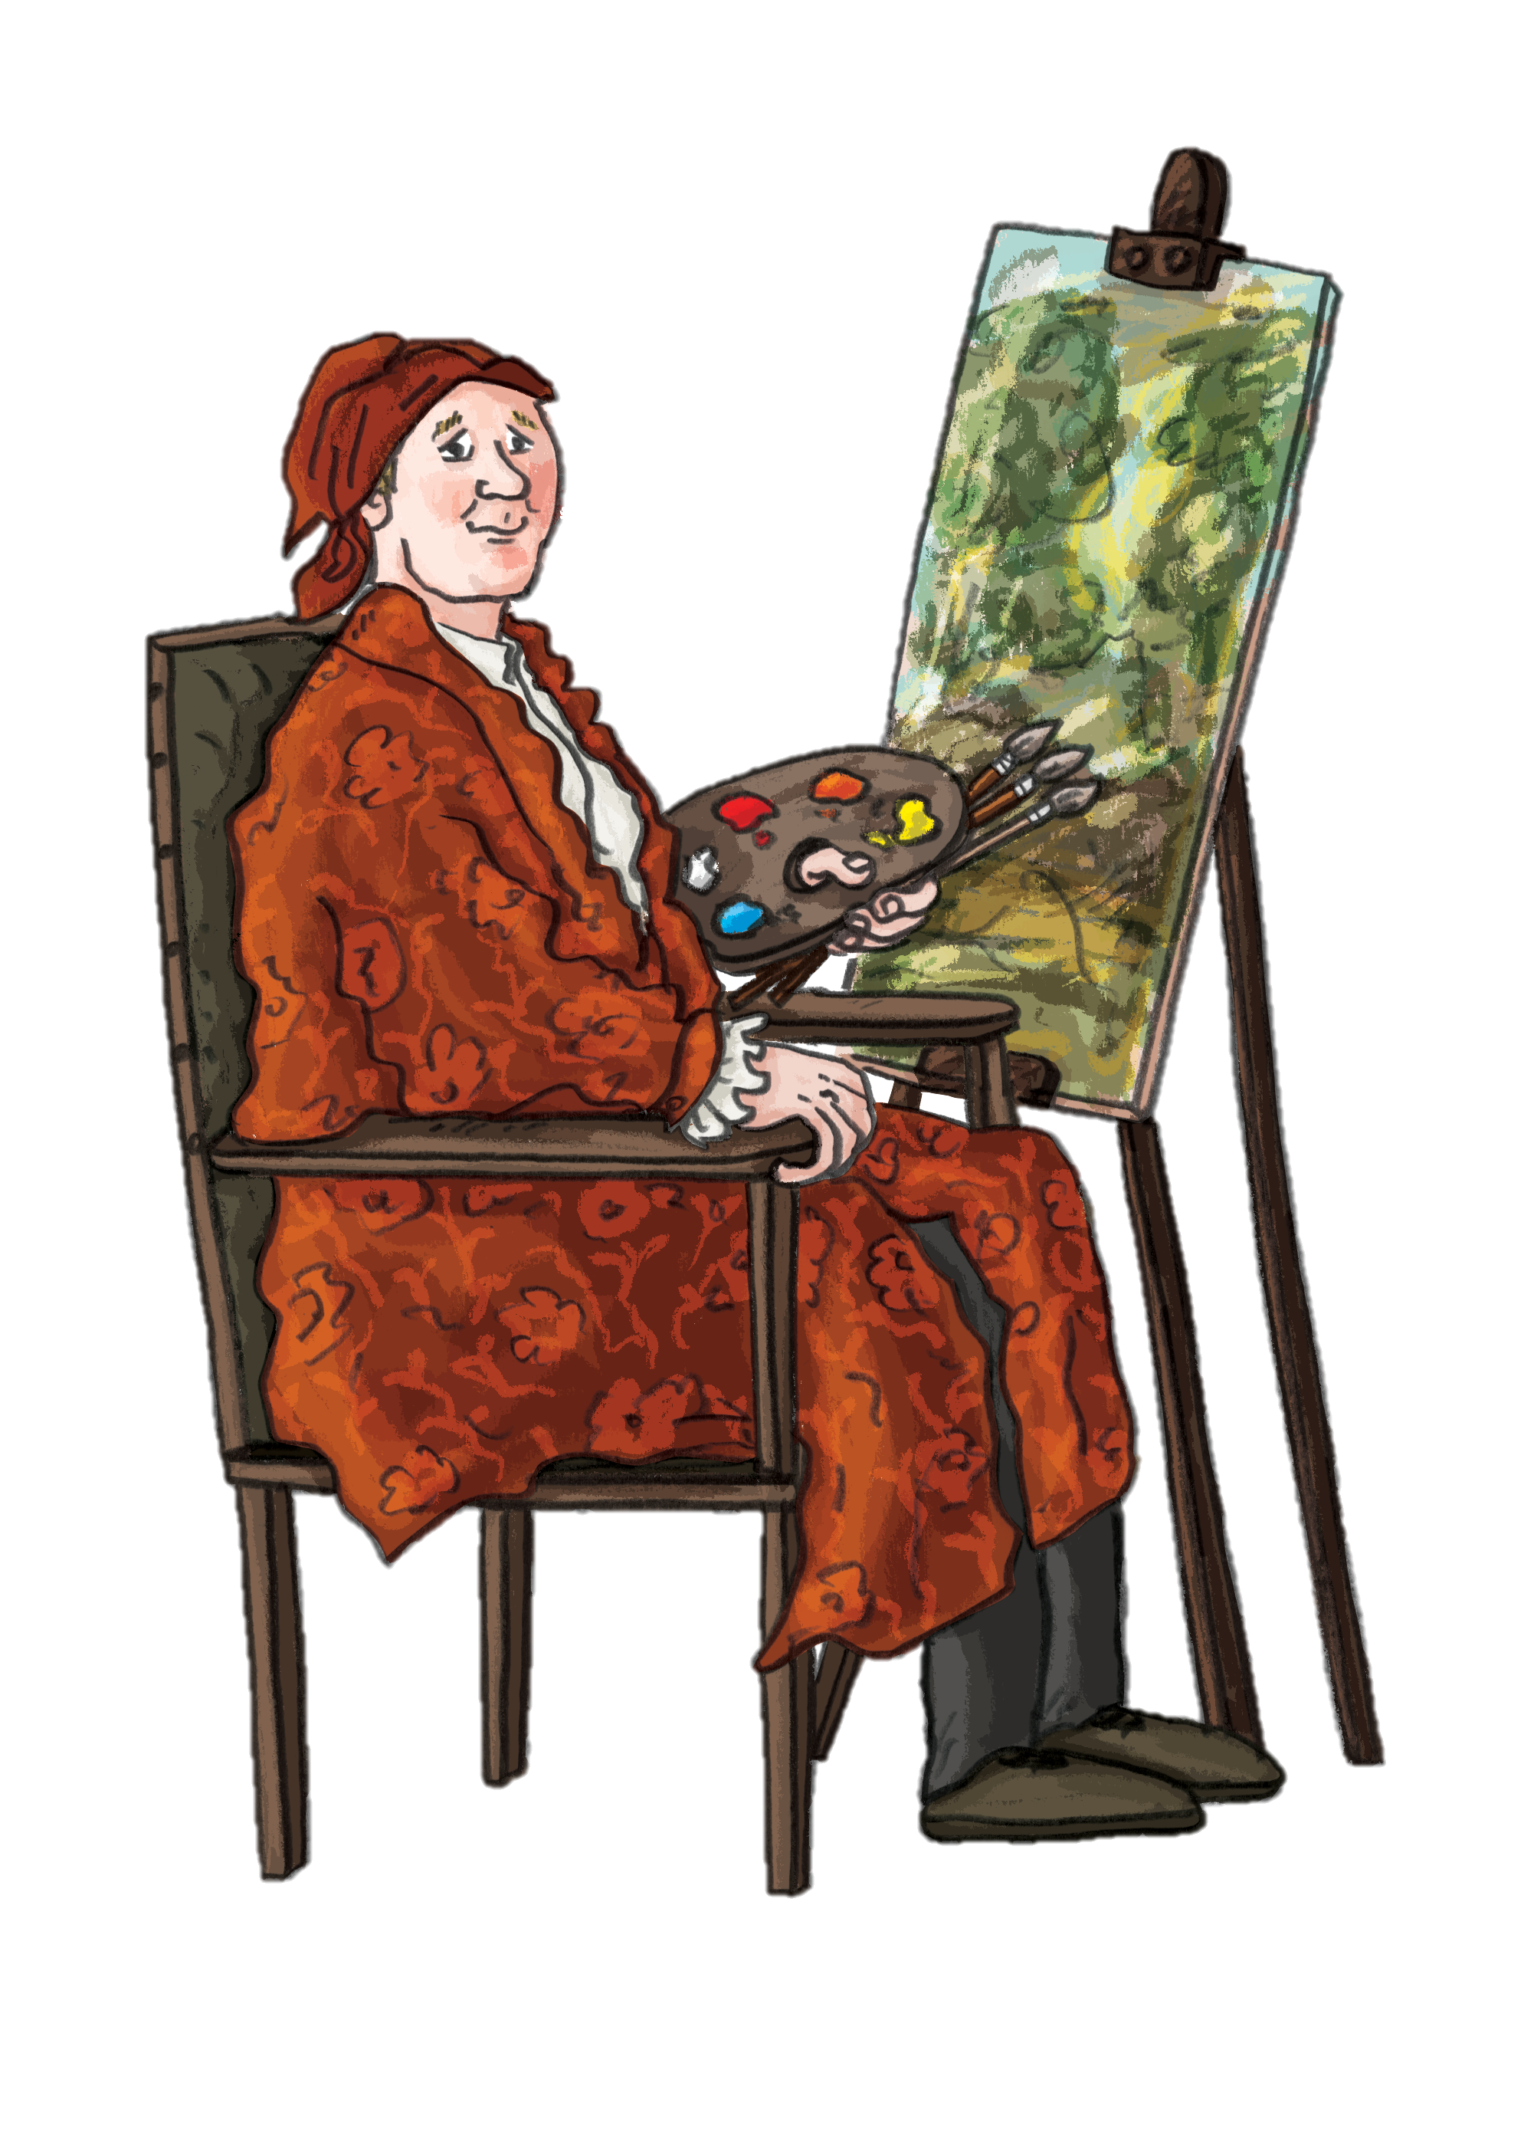
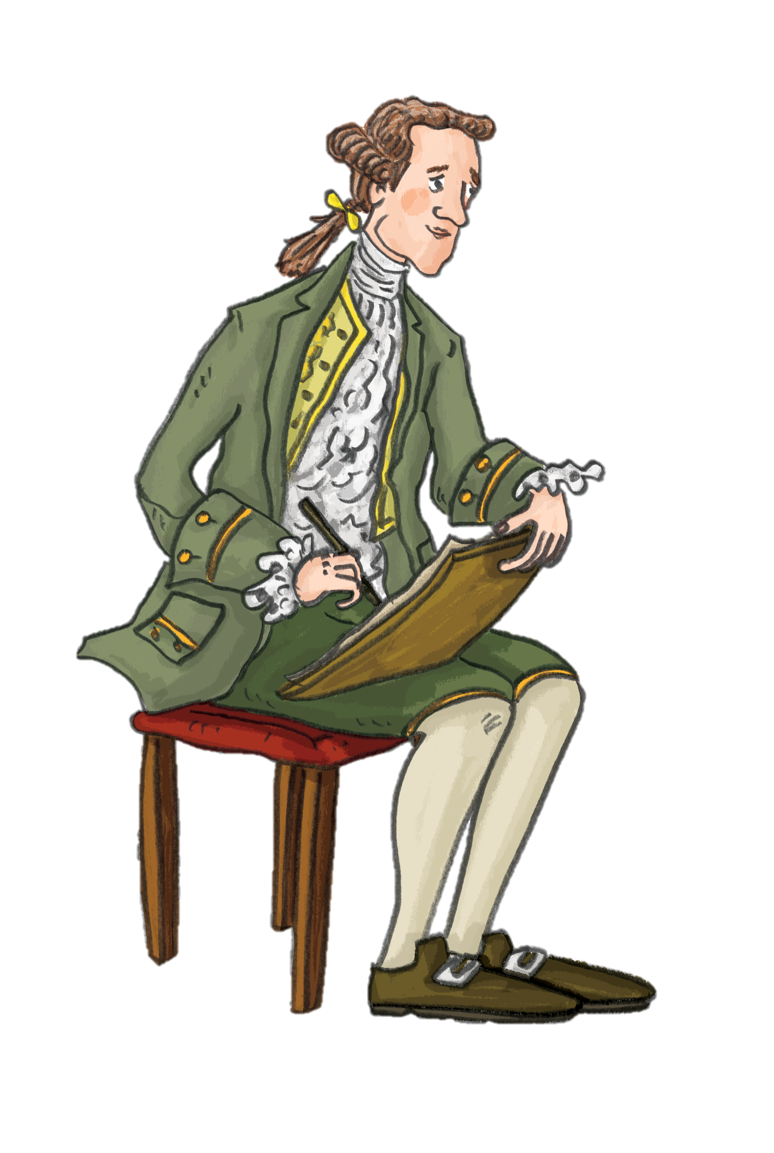

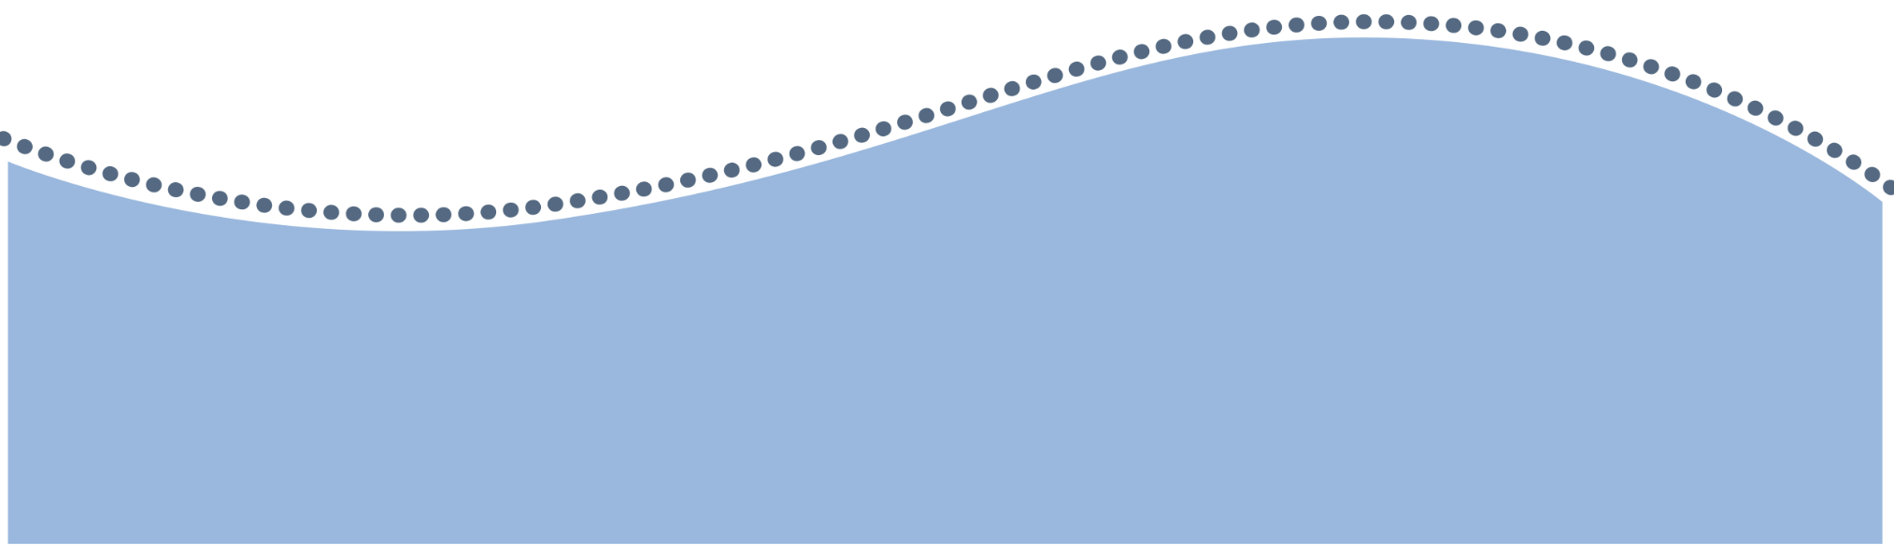
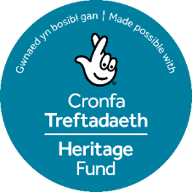
Famous Artists
in the Dee Valley
Let’s find out about the story of our Picturesque landscape and what led some of the most famous artists of their time to visit the Dee Valley!

Slide 2
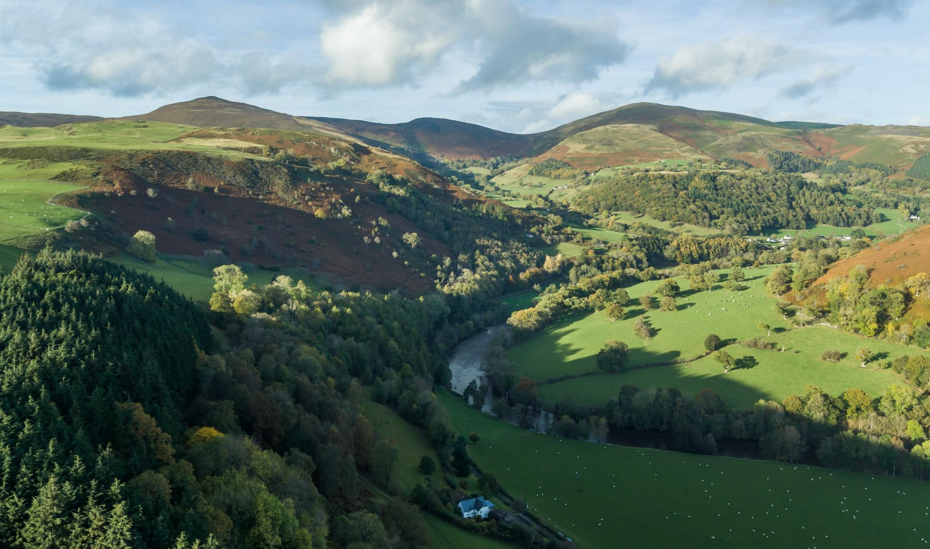

Journey to the past…
Our journey starts in the 18th Century when Sir Watkin Williams-Wynn inherited his estate in Ruabon.
The estate was huge covering five counties and included the Dee Valley.
Let’s find out more…

Slide 3
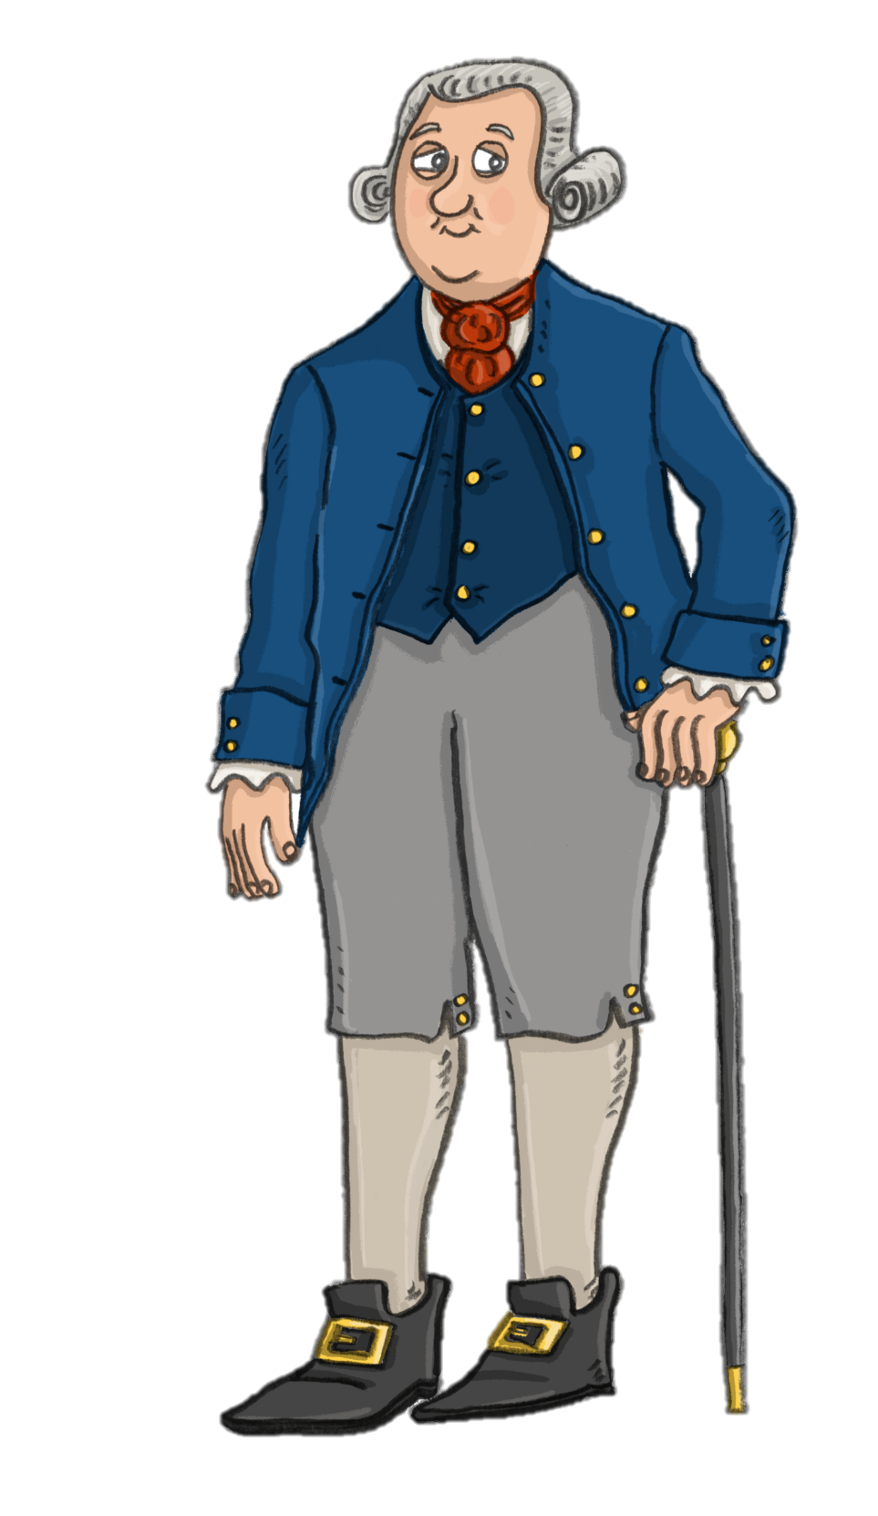
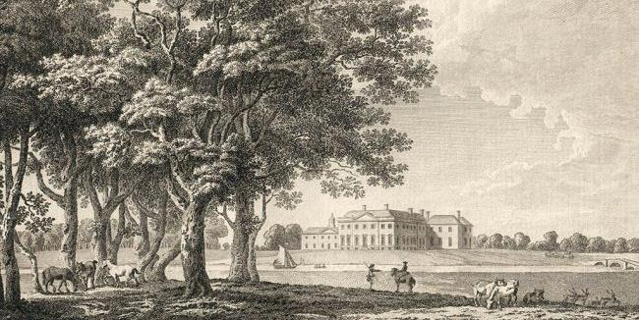
Sir Watkin Williams-Wynn
© Visit Wales
As a keen patron of the arts, Williams-Wynn invited the artists Richard Wilson and Paul Sandby to his estate to paint the views of the river Dee and Welsh hills.
Sir Watkin Williams-Wynn played a key part in the development of art in Wales, and the Dee Valley became the hub of artistic activity.
A 1778 engraving of the Georgian house at his estate in Ruabon from “The Copper Plate Magazine”. In the collection of the DiCamillo Companion.
Sir Watkin Williams-Wynn

Slide 4
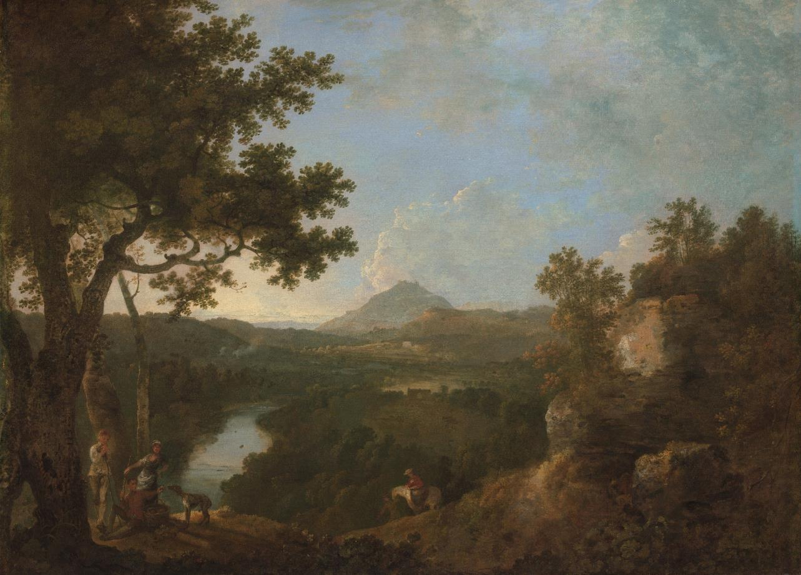
Richard Wilson
If you could invite an artist to paint a special place close to you, where would you choose?
© Visit Wales
View near Wynnstay, the Seat of Sir Watkin Williams-Wynn, fourth Bt.,1770-71, Richard Wilson. Yale Center for British Art, Paul Mellon Collection.

Slide 5
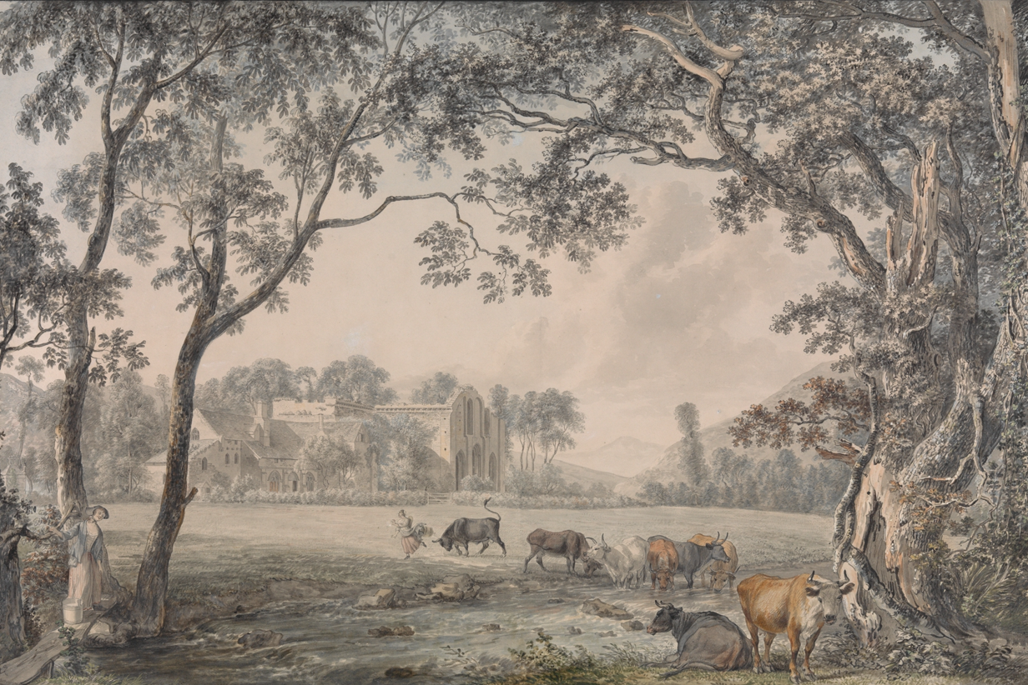

List some reasons why you might invite an artist to paint your special place.
Valle Crucis Abbey, Denbighshire, 1770-79, Paul Sandby. The Metropolitan Museum of Art, New York.
Paul Sandby

Slide 6
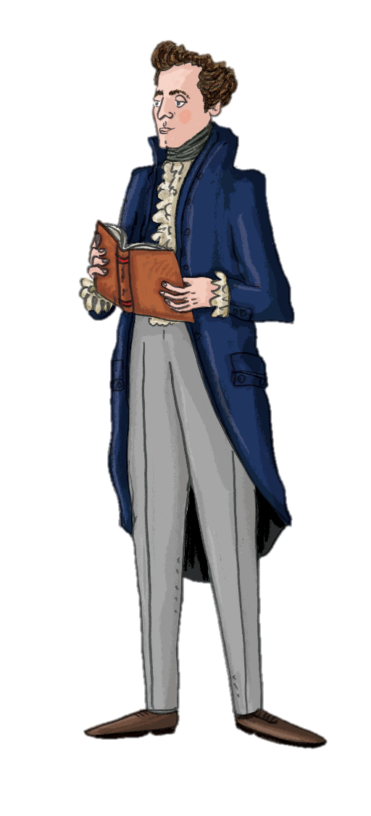
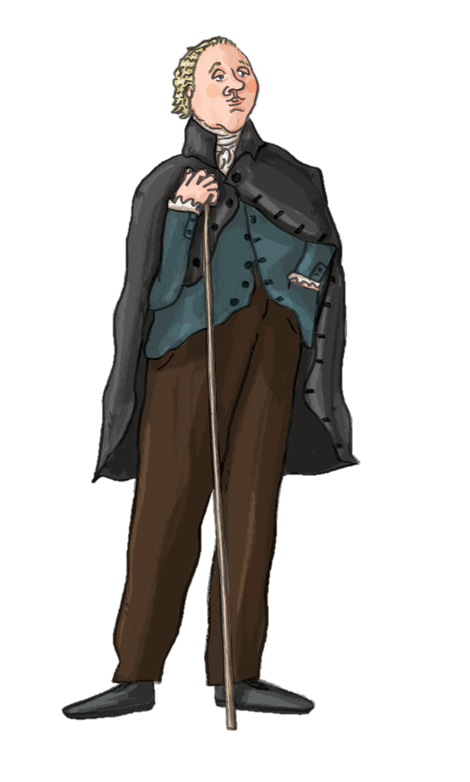
From paintbrush to pen
Thomas Pennant
As the paintings were published nationally, it encouraged more people to come and visit the area to enjoy the scenery, including some very influential travel writers who wrote some of the first tourist guide books.
In 1782, the idea of the Picturesque was famously defined by artist and author William Gilpin as ‘that peculiar kind of beauty which is agreeable in a picture’. The stunning scenery of the Dee Valley attracted further artists and writers including Thomas Pennant, George Borrow, Edward Pugh and Joseph Mallord William Turner, drawn to the area in search of the sublime.
William Gilpin

Slide 7
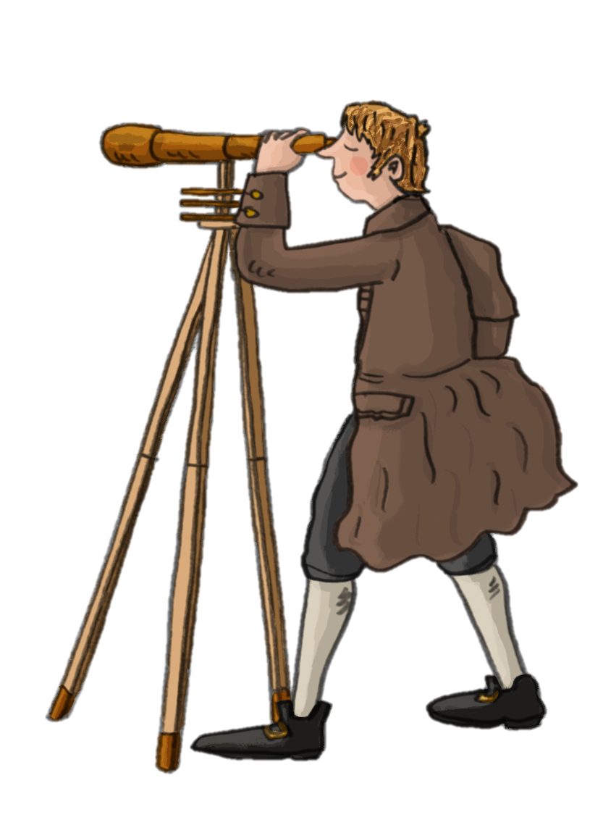
Joseph Mallord William Turner
Today J.M.W. Turner is perhaps the best-loved English Romantic artist.
Turner was born in London in 1775. He became known as 'the painter of light', because of his interest in brilliant colours. With his new techniques and ideas, his paintings stood out amongst the more traditional styles of the Old Masters.
Turner painted a huge variety of subjects including mythical, architectural, land and seascapes, as well as recording events, both past and present. He used watercolours and oil paints and even practiced engraving.
His routine was to tour and sketch in the summer, and during the winter he worked on finishing the final pieces (alongside commissions) in his studio.
J.M.W. Turner

Slide 8
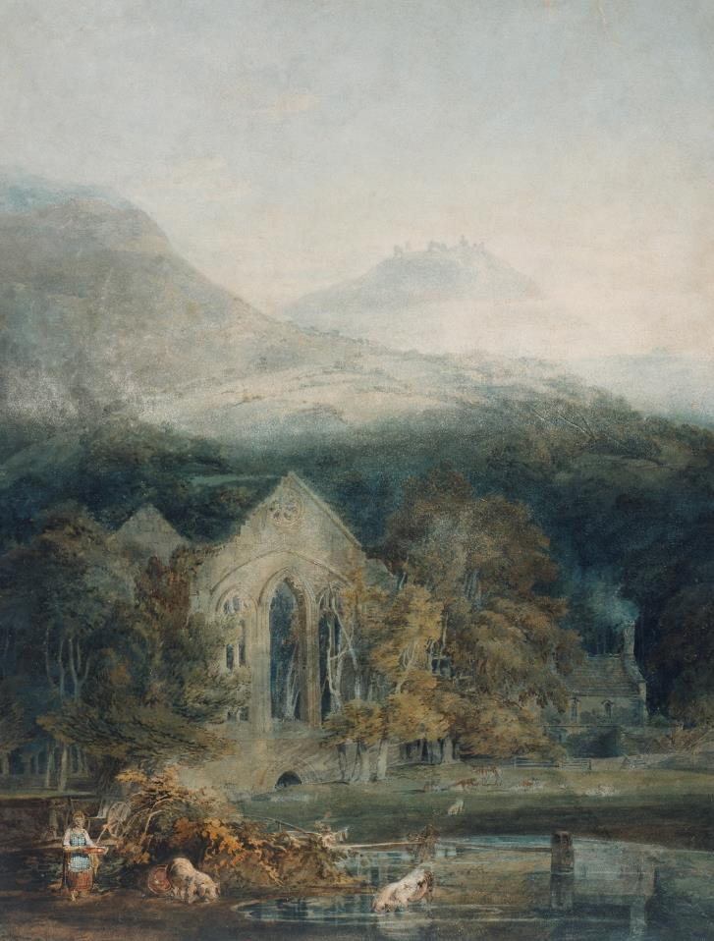

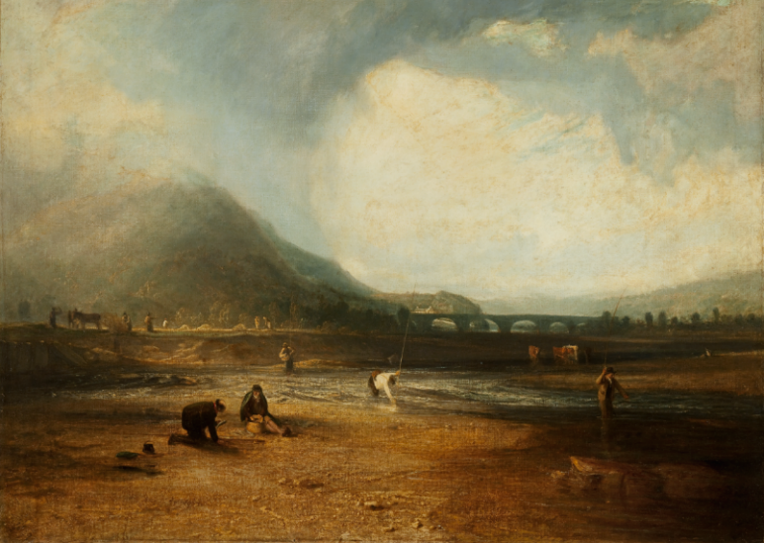
In 1798, Turner followed in the footsteps of the earlier artists and painted now famous pieces such as the fishermen on the River Dee, Valle Crucis Abbey and Castell Dinas Brân. These would have been some his early works and first tours, which helped him become the famous artist many people know of today.
J.M.W Turner
Valle Crucis Abbey with Dinas Brân, 1794-5, J.M.W. Turner. Photo: Tate.
J.M.W Turner
The Trout Stream, 1809, J.M.W. Turner. Courtesy of the Taft Museum of Art, Cincinnati, Ohio. Tony Walsh Photography.

Slide 9
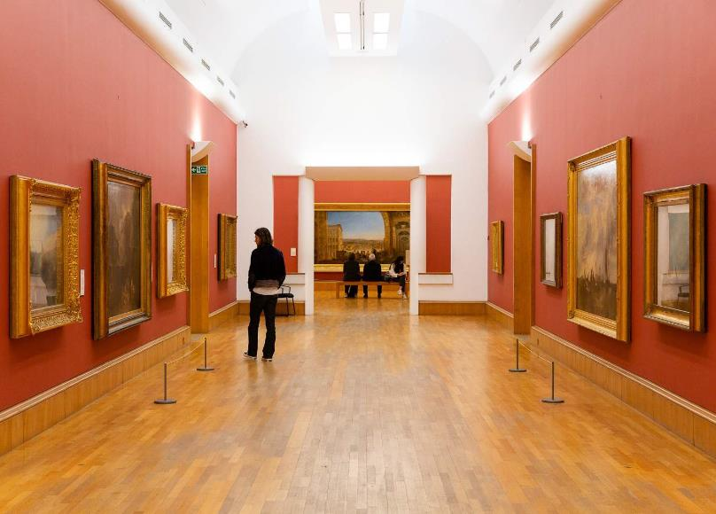

Turner’s Legacy
He died in 1851 after suffering from cholera.
Turner’s remains were interred in the crypt of St Paul’s Cathedral in London alongside other famous artists.
Turner bequeathed much of his work to the nation. The great majority of the paintings are now at the Tate Britain in London. He left behind more than 550 oil paintings, 2,000 watercolours and 30,000 works on paper.
Quiz
Today you will find Turner’s image on the £20 note and the Turner Contemporary Gallery in Margate, Kent (where he often stayed) is named after him.
Tate Kids
Who is J.M.W. Turner?

Slide 10

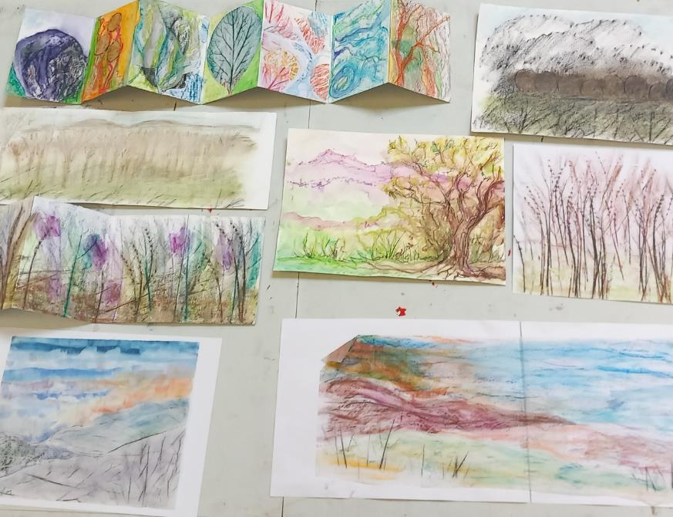

Activities
Follow the link above to hear about one of Turner’s later landscape paintings and the techniques he used to create it.
Also you can get arty out and about just like Turner and try some of our Wild Art activities!
Watch
How Turner Revolutionised Watercolour Painting
Click here for
Wild Art Activities

