Slide 1
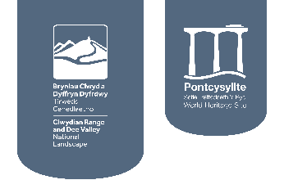
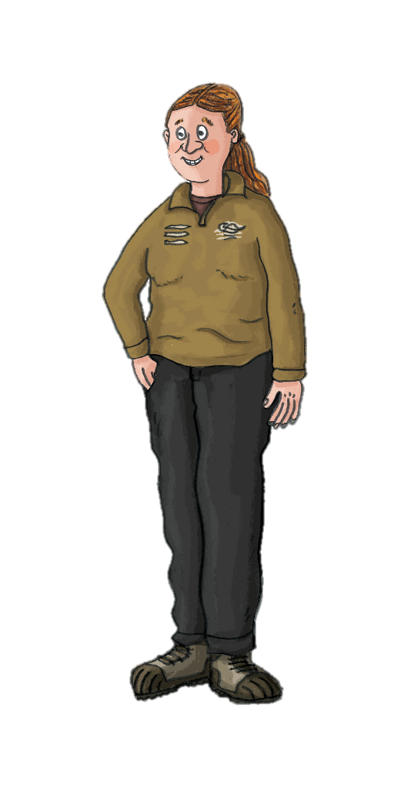
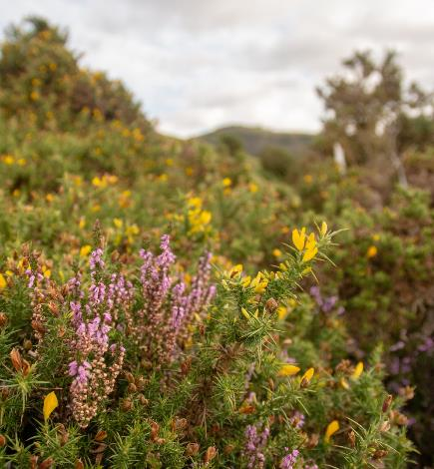

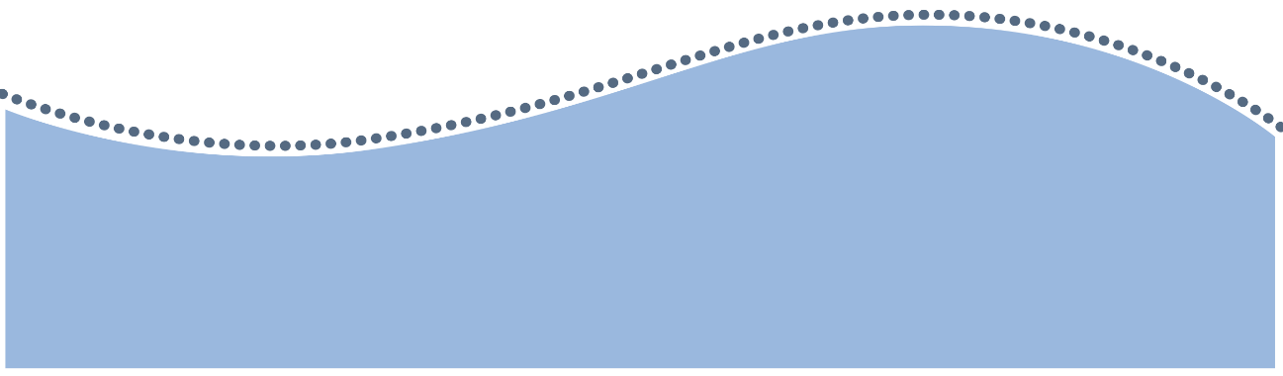
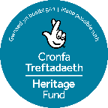
Ffridd Habitat
Ffridd is a special type of habitat and an important feature of the Welsh countryside.
It is a habitat under threat.

Slide 2
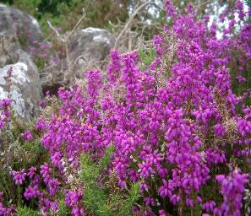

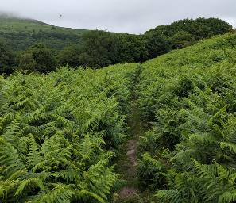

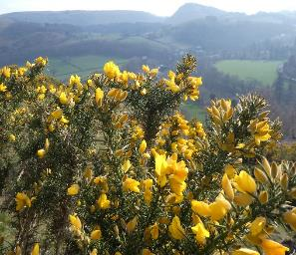
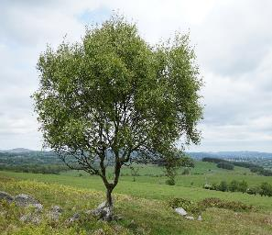
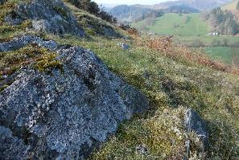
What is ffridd?
Ffridd is often described as a mosaic or patchwork habitat as it is made up of a mixture of different vegetation.
You will often find a mixture of grass, heathland, bracken and patches of scattered bushes and small trees.
You might see rare plants and fungi and sometimes streams, swamps and ponds.

Slide 3
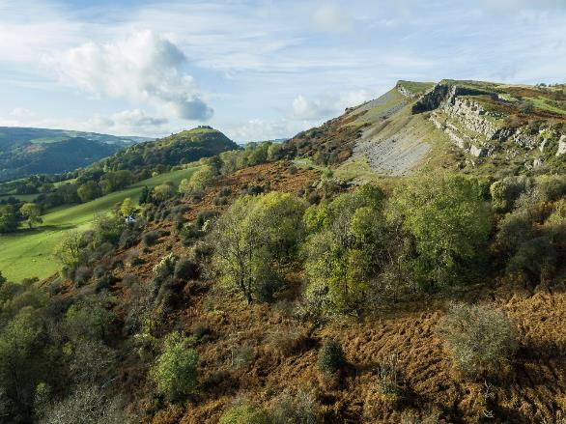


What does ffridd look like?
Ffridd areas are found sandwiched between upland and lowland areas and take features from both these habitats. The ffridd habitat is an important ‘corridor’ in the countryside.
Upland
Rocky, hilly and mountainous with cooler temperatures.
Lowland
Flat, warmer and good for growing.
Ffridd habitat
Patchwork of vegetation, haven for wildlife.
Can you see the patchwork of different plants in the ffridd?

Slide 4
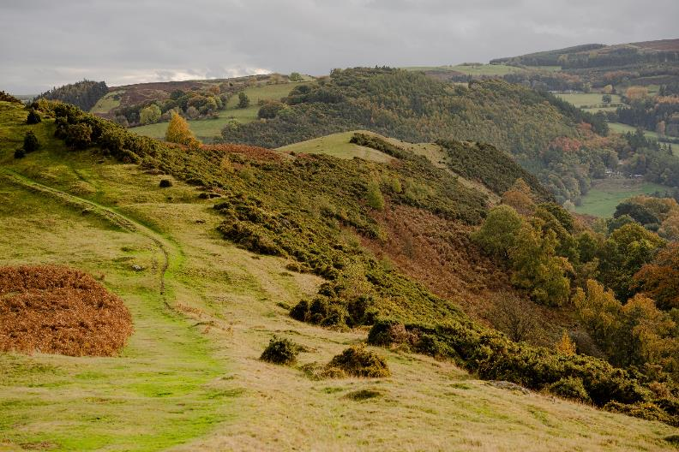


Can you locate the ffridd habitat in this picture?
Why is ffridd
important?
Ffridd supports a variety of plant and animal species that have adapted to live between upland and lowland environments.
Ffridd supports a variety of plant and animal species that have adapted to live between upland and lowland environments.
These ‘corridors’ help plants to spread, provide food for wildlife and help animals to move around and find shelter.

Slide 5
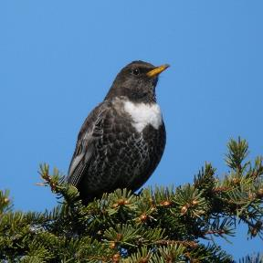
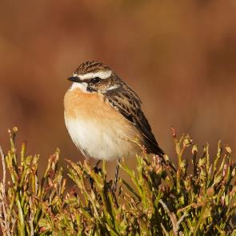
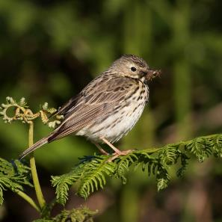
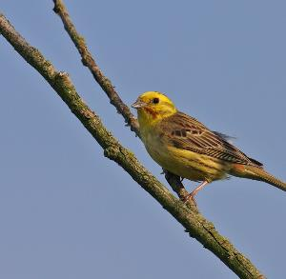
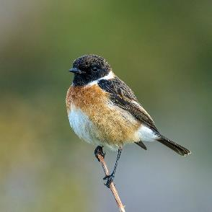
Extra-special species found in ffridd… Birds
Whinchat
Ring Ouzel
Tree Pipit
© Frank.Vassen via
Wikimedia Commons
© Liz Cutitng
© Liz Cutting
Stonechat
Yellowhammer
© Andreas Trepte via
Wikimedia Commons
© Chris Clark

Slide 6
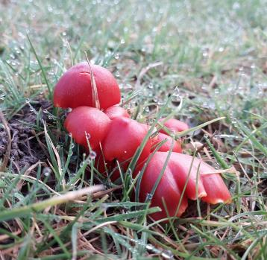
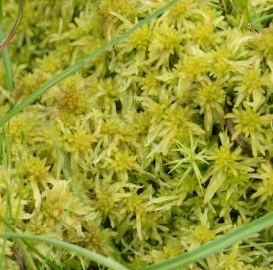
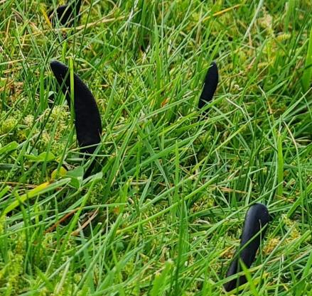
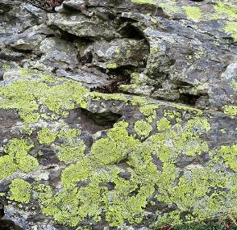
Grassland Fungi, Lichen and Moss
Sphagnum Moss
© Mike Pennington
Scarlet Waxcap
Earth’s Tongue Fungus
Lichen
© Llywelyn2000 via
Wikimedia Commons

Slide 7
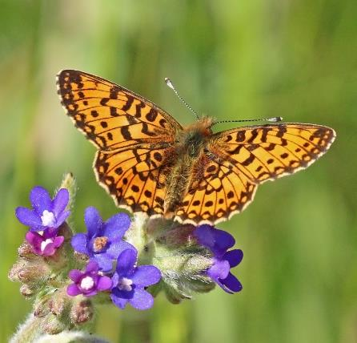
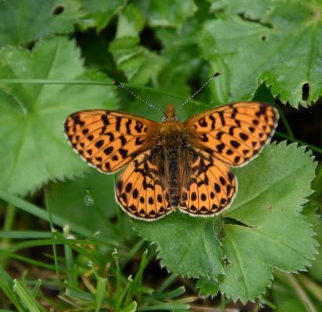
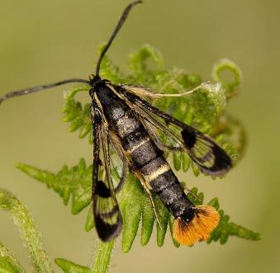
© Charles J. Sharp via
Wikimedia Commons
Butterflies and Moths
Small Pearl Bordered Fritillary
Pearl Bordered Fritillary
Welsh Clearwing Moth
© Butterfly Conservation

Slide 8
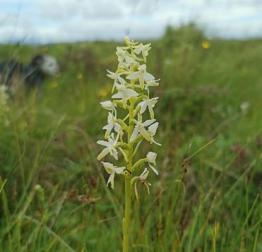
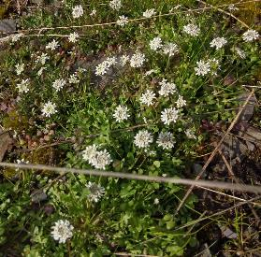
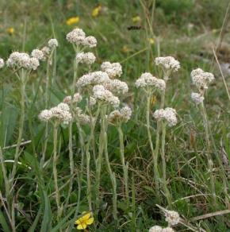
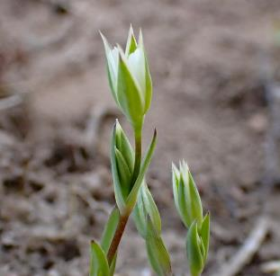
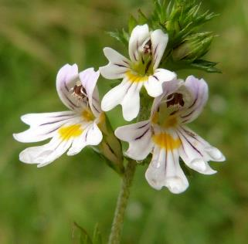
Plants
Lesser Butterfly Orchid
Shepherd’s
Cress
Mountain Everlasting
Upright
Chickweed
Eyebright

Slide 9
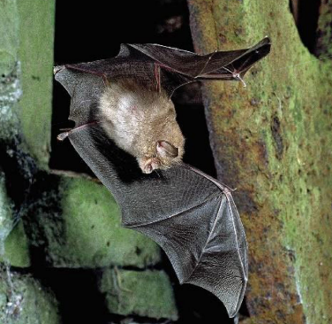
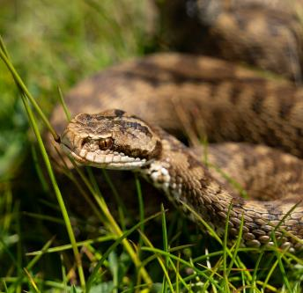
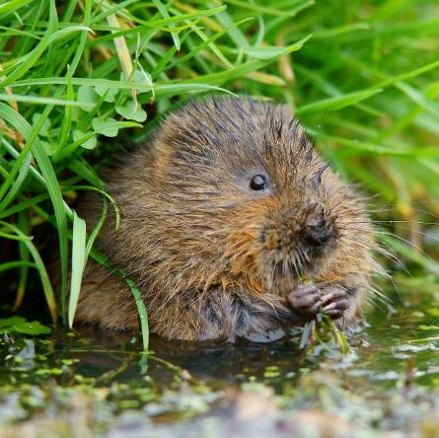
Mammals and Reptiles
© Agriland
© Peter Trimming
Adder
Lesser Horseshoe Bat
Water Vole

Slide 10
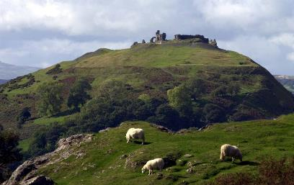

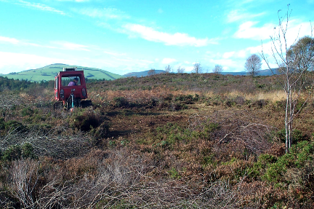
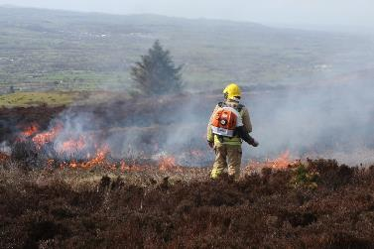
Managing ffridd
Grazing
Ffridd is semi-natural which means it needs help from people to stop it from eventually turning into woodland.
Bracken and gorse can take over areas of ffridd if they are not controlled by:
Machines
Controlled burning

Slide 11
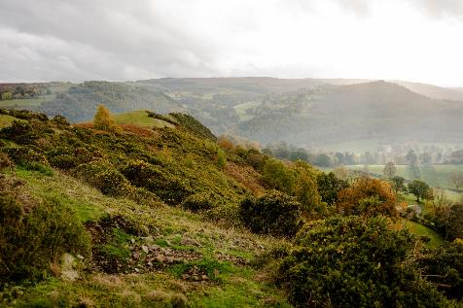
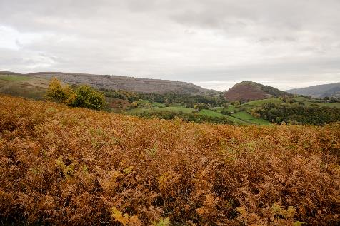
Managing ffridd
Good ffridd mosaic
Without control, bracken, gorse and trees will grow too thick and the varied patchwork habitat of the ffridd will be lost.
Poor ffridd mosaic
Compare the two images
What differences do you notice?
Why do you think animals and plants may struggle in a poor ffridd mosaic?

Slide 12
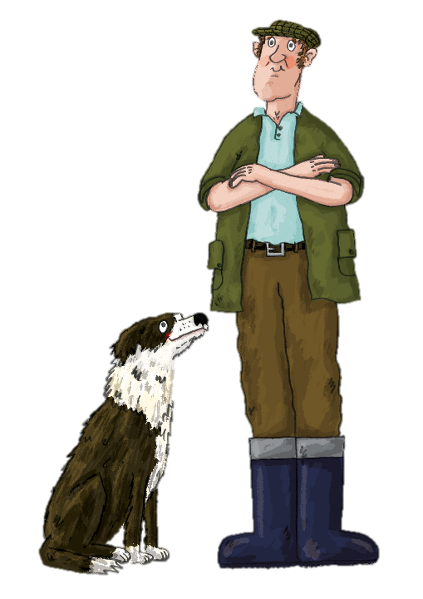


Farmers and ffridd
Let’s take a look at how different animals on my farm impact the landscape…
Farmers often have cattle, sheep and horses to graze (eat the plants) on areas of ffridd.
A mix of grazing animals can help prevent plants from taking over as they are different in their behaviour and size and will eat plants in different ways.

Slide 13
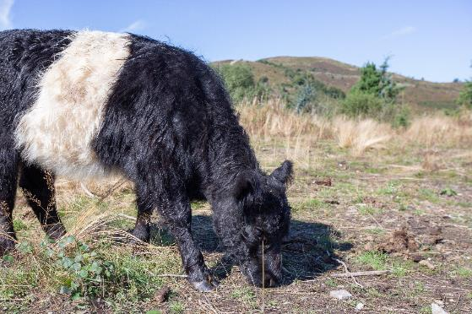
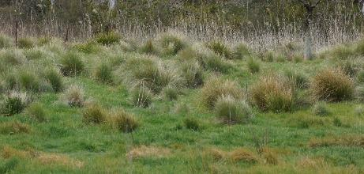
Grazing animals - Cattle
Cattle let the grass grow longer and in patchy clumps (tussocks). They are heavy and create scrapes and hollows with their hooves which are perfect for ground nesting birds!
Their large size means they are good at making gaps in the bracken and bushes.
Tussocks are good for insects and small mammals to shelter beneath. These are an important food source for birds and larger mammals.

Slide 14
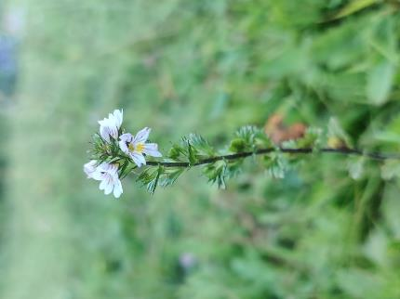
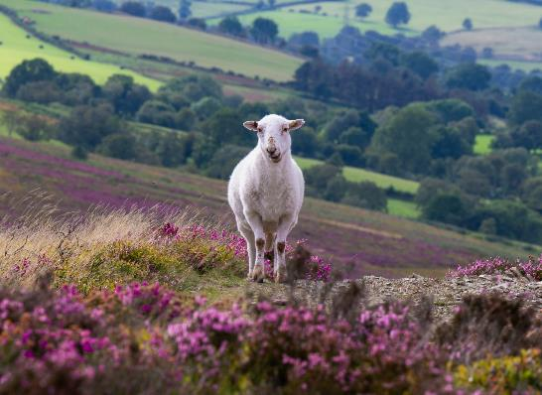
Grazing animals - Sheep
Sheep nibble at fresh shoots and eat the grass down low. They are light weight and agile on the steep slopes and are gentle on the soil and ground.
Sheep eat and control the scrub areas naturally but will often eat special plants too!

Slide 15
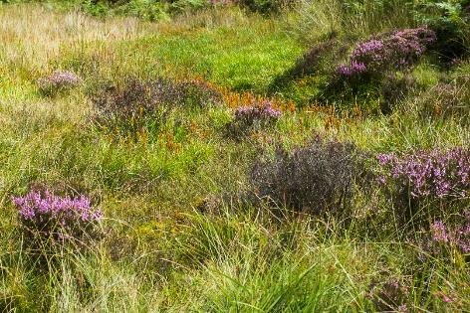
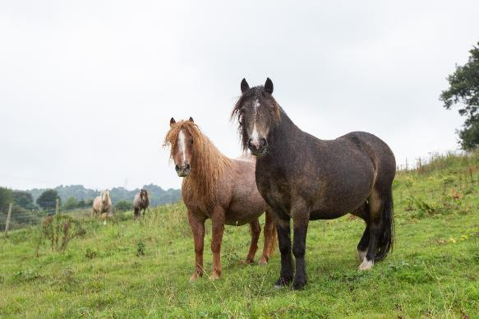
Grazing animals - Horses
Horses like sweet tufted grasses and will nibble tough plants like gorse and bracken, but tend to leave flowers alone.
They are heavy enough to trample down the thick bracken which lets special plants flower beneath.

Slide 16
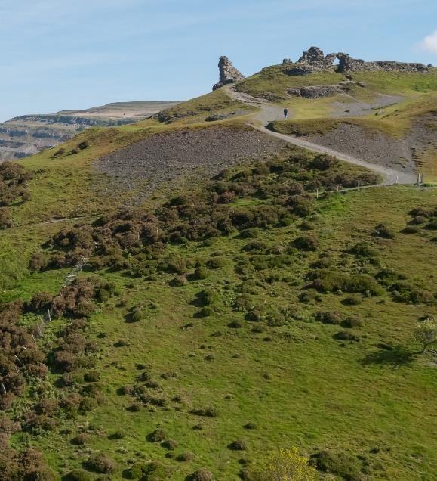


Case Study
At Castell Dinas Brân (a Special Area of Conservation), rare and specialist plants such as Upright Chickweed and Shepherd’s Cress need short, dry grassland to thrive.
Countryside rangers and volunteers clear bracken away so the important plants have space to grow.
Look out of the classroom window, can you spot any ffridd?

Slide 17
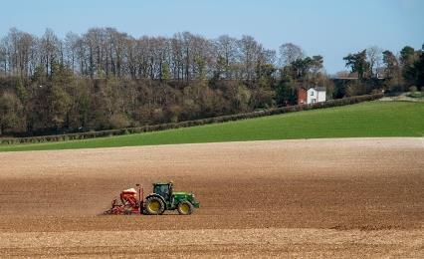
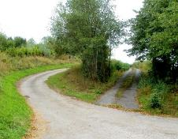
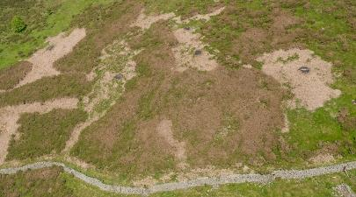
Why is ffridd under threat?
Clearing - Ffridd used to be cleared and drained in favour of improved grassland (grassland seeded and fertilised as food for farm animals).
Land Use Changes - Human activities such as urban development (buildings and roads), forestry and intensive farming can split up areas of ffridd habitat and disrupt the species that live there.
Poor Management - Too much or too little grazing or controlled burning will affect the balance between different species. Land managers must find a balance to keep the special ffridd patchwork intact.

Slide 18
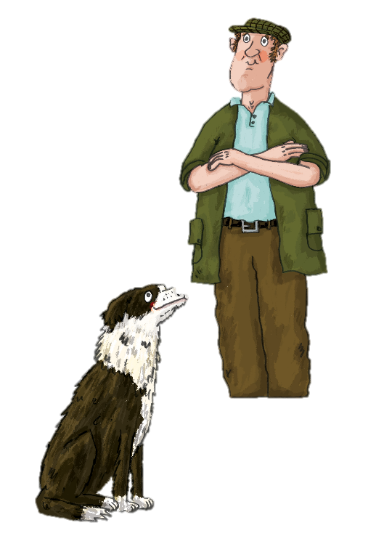
How can we protect ffridd?
Teach people how to respect and enjoy ffridd habitats (no BBQs, off-roading, keep dogs on leads).
Support and volunteer with local conservation projects.
Educate landowners and managers about the importance of ffridd’s biodiversity and how to manage it carefully.
Monitor and record plant and animal species so changes can be spotted.

Slide 19


Poster ideas:
I love ffridd
Habitats
are homes
Love where I live
Activity 1:
On your own or in a pair, create a poster or advert (radio/TV or social media style) to tell other people why ffridd is an important habitat.
Use the PowerPoint slides to help you.
Notes:
Note to teachers in order to reflect slide number 18 - make a display of the posters and use coloured paper to represent heather, bracken, scrub and gorse and encourage children to illustrate details onto the paper to make a ffridd habitat background. Take a photo to share on school social media to spread the word! Please include links to the Ffridd section on Clwydian Range and Dee Valley National Landscape website for more information for parents and link back to our social media accounts too.

Slide 20
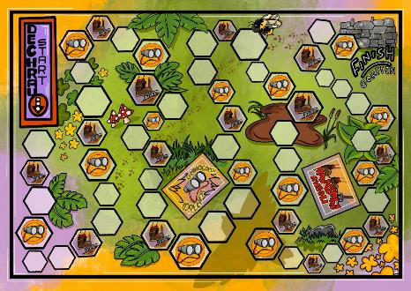


Activity 2:
Play the Ffridd Habitat board game and see how you get on managing the land.

