Slide 1

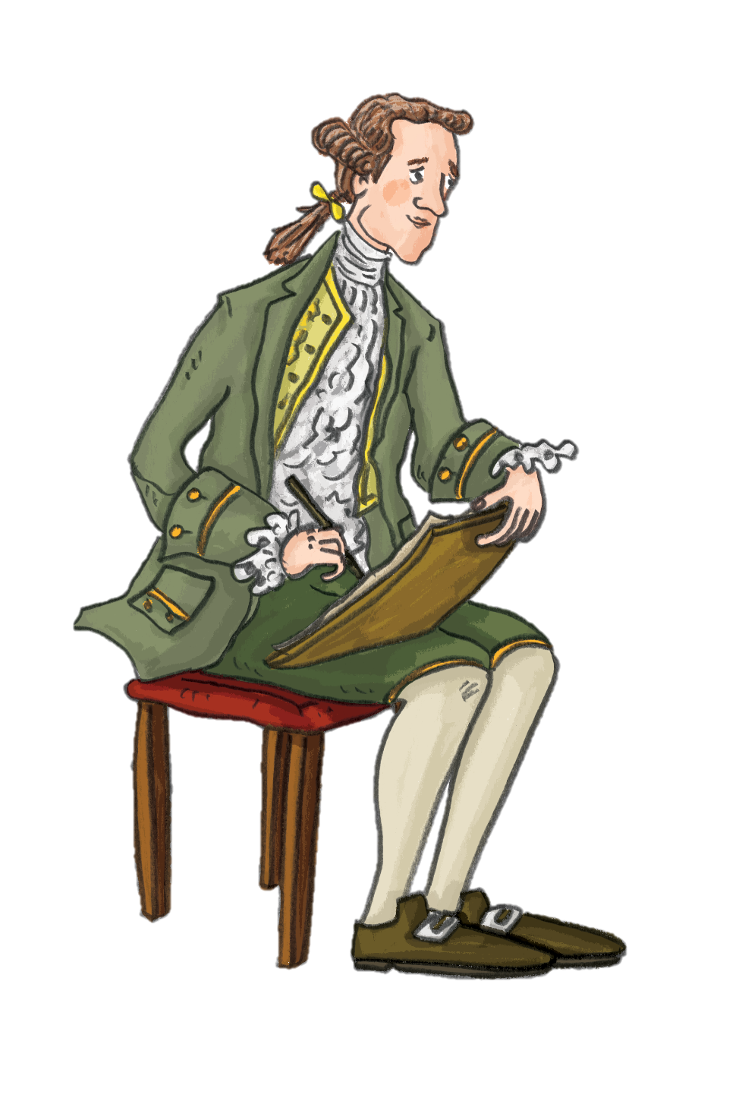
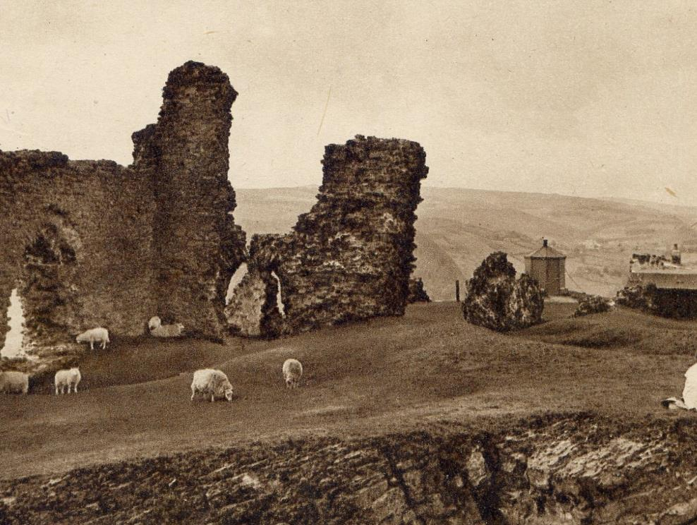

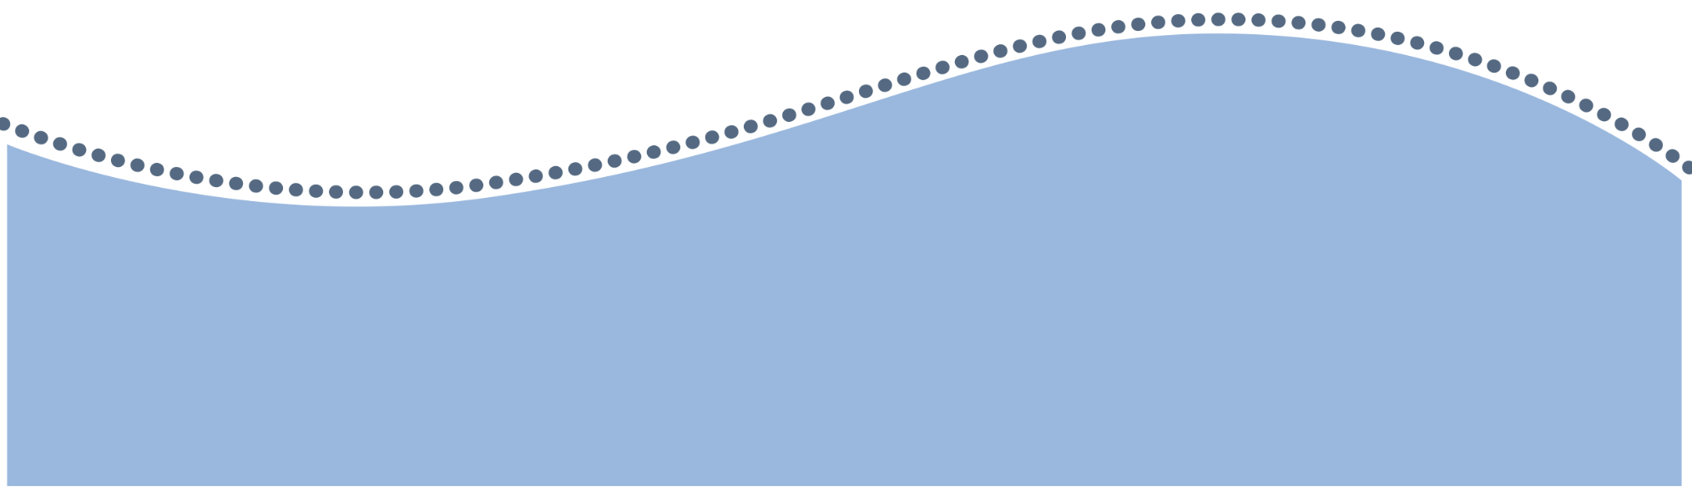

Listen and Create!
Artists and creatives have been inspired by the picturesque beauty of the Dee Valley for centuries!
With this podcast activity, let your creativity flow as you take part in one of the hands on craft activities.

Slide 2
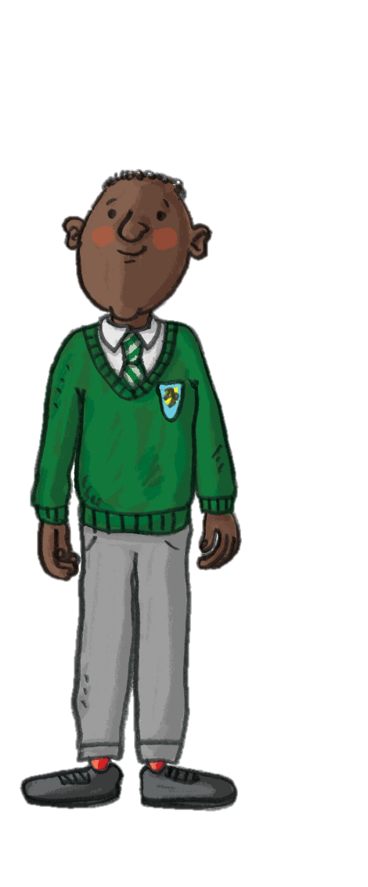


Listen and Create
Learning Objective:
To use my listening skills to learn about the history of tourism in the Dee Valley.
Success Criteria
Listen to the podcast and recall details to other people.

Slide 3

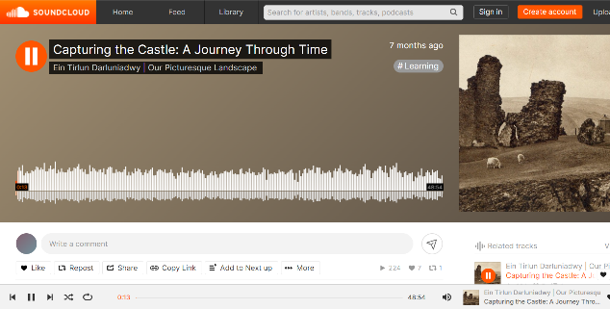

A Journey through Time
Everywhere you go in the Vale of Llangollen, history is intertwined with the present day.
As you listen to the podcast you will hear from people in the Dee Valley both past and present, as you follow an imaginary walk from Llangollen Bridge to Dinas Brân Castle.
Listen
Capturing the Castle:
A Journey through Time podcast

Slide 4



As you listen to the podcast, sketch some of the things you hear onto a piece of A3 paper to make an expressive piece to accompany the spoken words.
You could include drawings, patterns and words.
Activity 1:
Mindful Sketching
You will need:
A3 paper
Coloured pencils

Slide 5
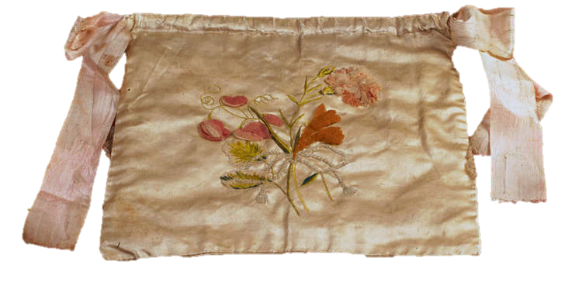
Like many women from the 18th Century, the Ladies of Llangollen were keen on sewing and embroidery.
Activity 2:
Postcard Embroidery
Inspired by the hobbies of the Ladies of Llangollen, draw with stitch to make patterns and shapes to complement a postcard image.
You will need:
Postcards printed on card
Embroidery needles
Embroidery thread
Scissors
Tape
Here is an example of Sarah Ponsonby’s embroidery.
Notes:
Cutesy Crafts 13 hand embroidery stitches for beginners, the video is split into individual stitches. https://www.youtube.com/watch?v=V95uh5nQZic Beginners may find it easier to do the following 6 stitches; running, back, split, stem, chain and French knot.

Slide 6
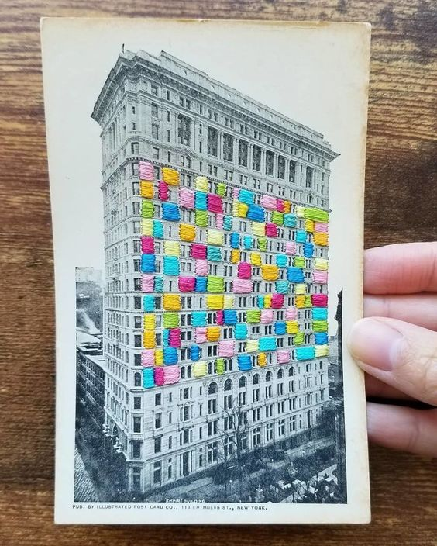
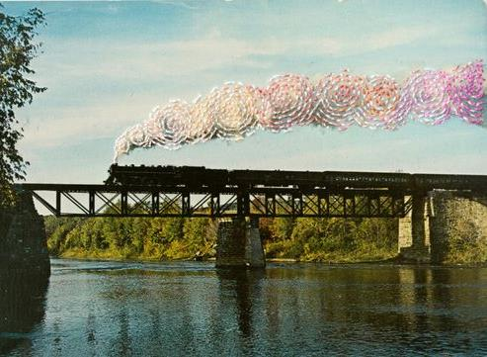
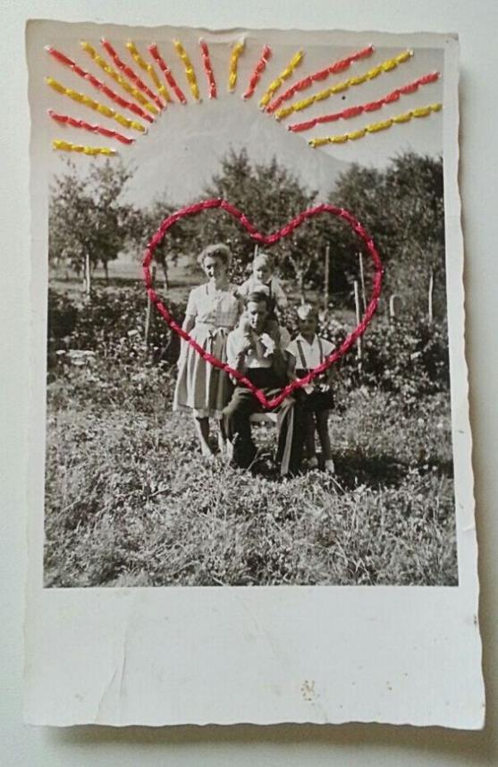
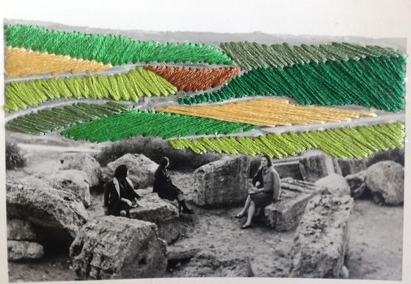
Inspiration – Postcard Embroidery

Slide 7

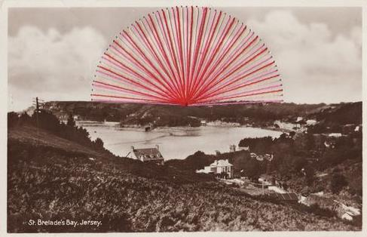
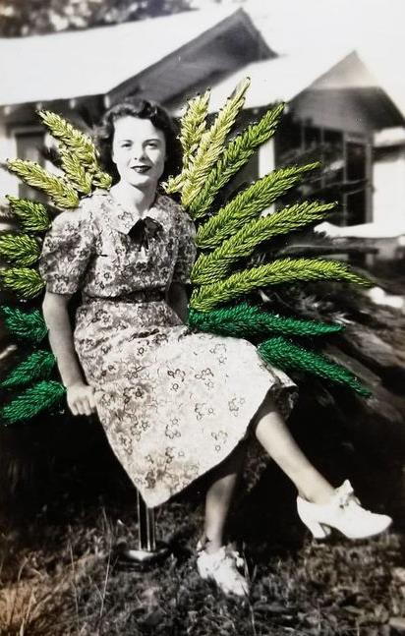
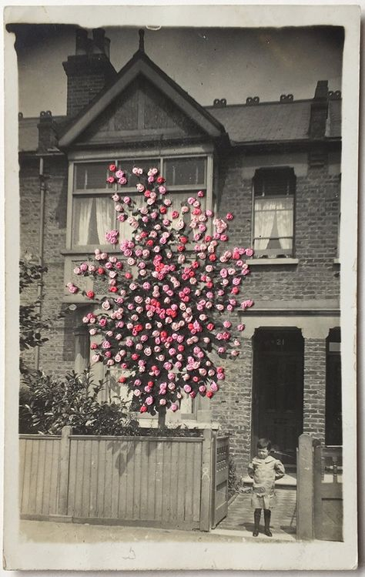
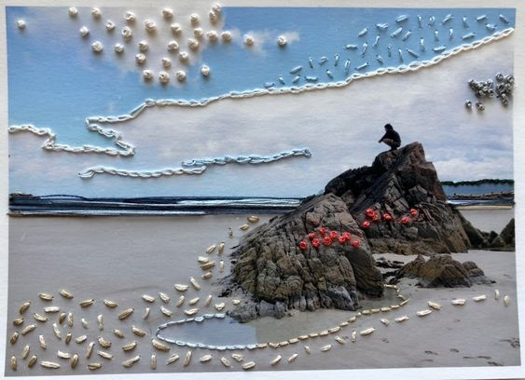
Inspiration – Postcard Embroidery
Notice how the image can change with the addition of colour, characters and shapes!

Slide 8


As you listen to the podcast, draw some of the historic characters, places and activities onto old postcard images of the Dee Valley.
Activity 3:
Ghosts of the past
You will need:
Printed postcards
Drawing equipment

Slide 9
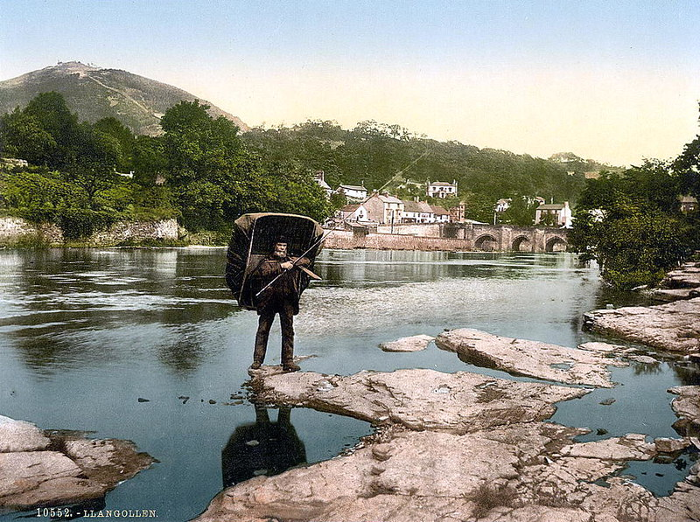
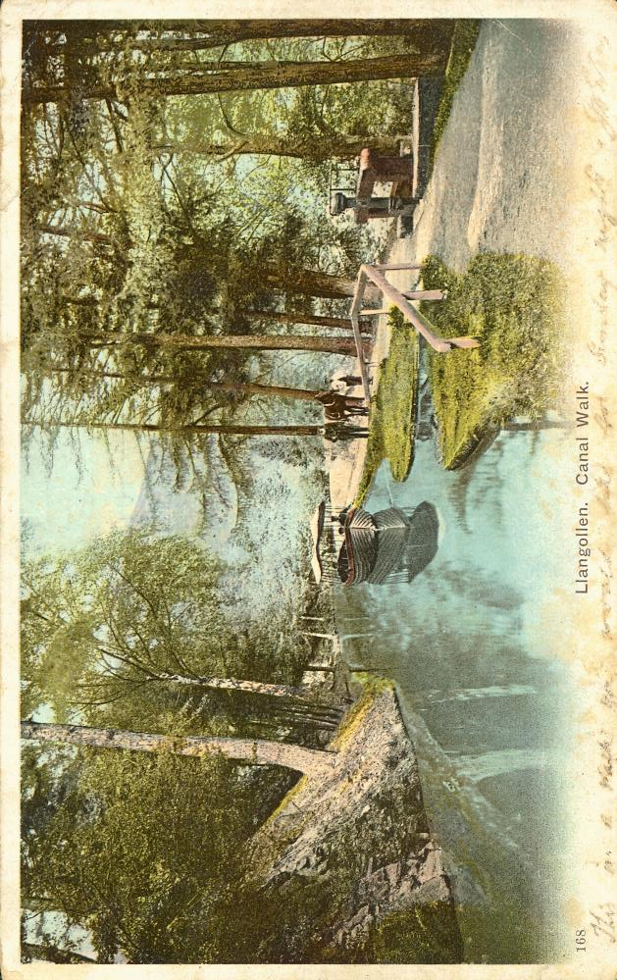
Resources – Dee Valley Postcards

Slide 10
Resources – Dee Valley Postcards

Slide 11
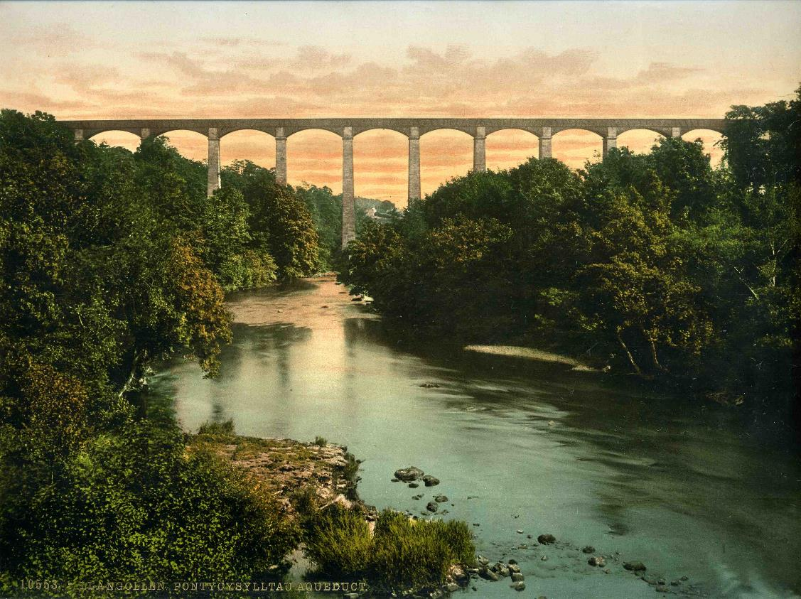
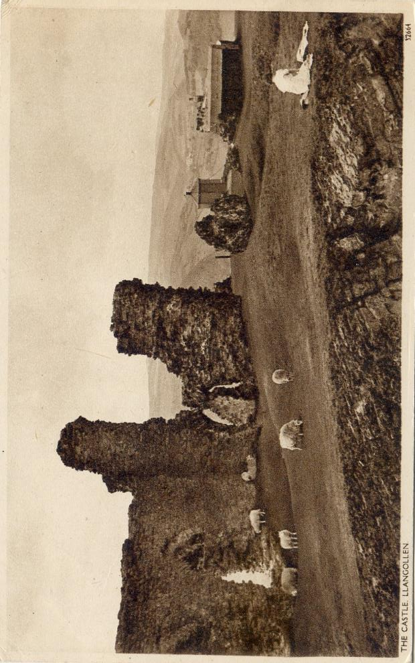
Resources – Dee Valley Postcards

Slide 12
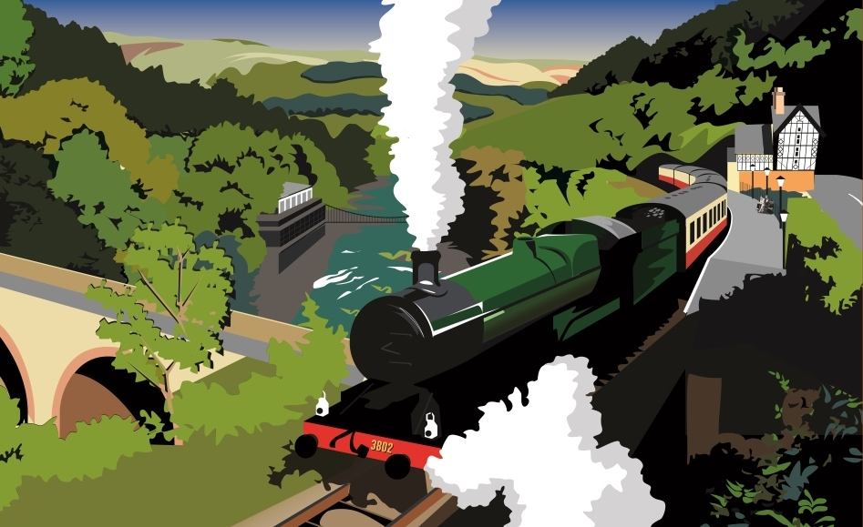
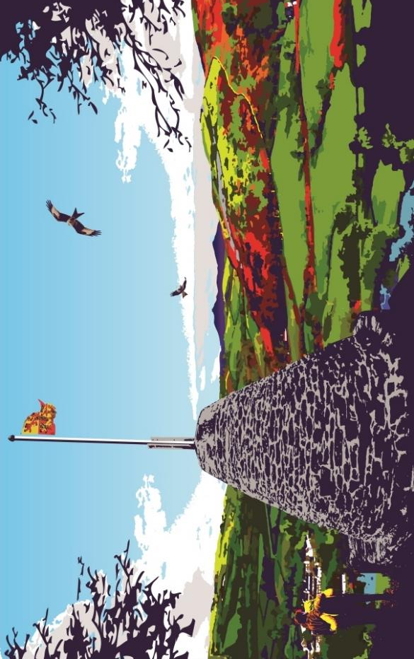
Resources – Dee Valley Postcards

