Slide 1

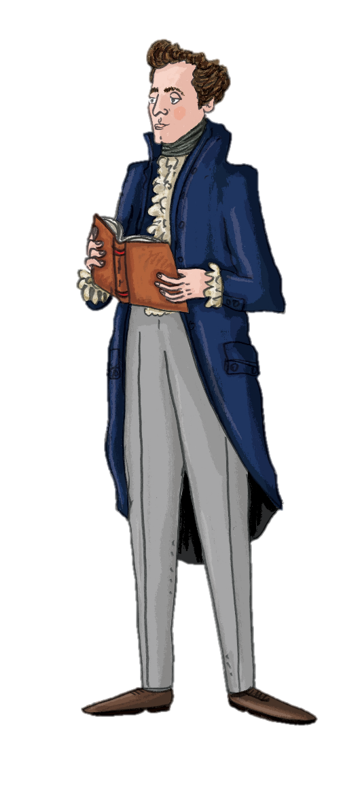

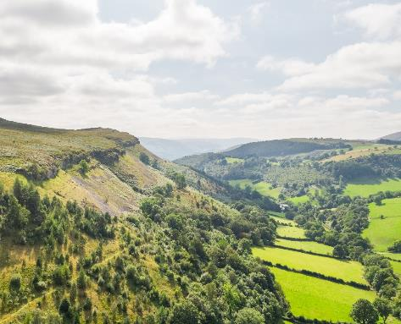


Poetry and
Creative Writing
I’m George Borrow, a famous travel writer! People have written about and been inspired by the landscapes of the Dee Valley for centuries. Each piece offers a glimpse into the landscapes of those eras through different lenses.
Let’s see what they had
to say...

Slide 2
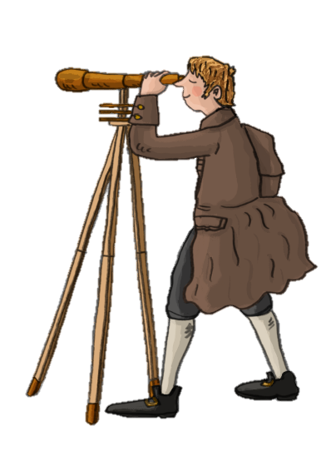
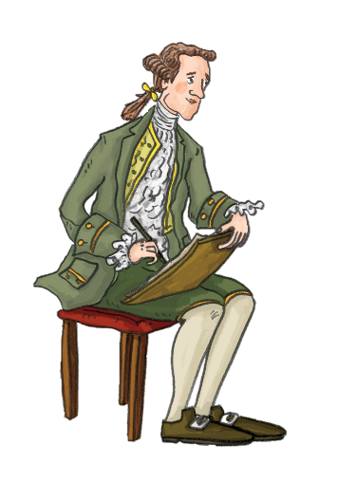
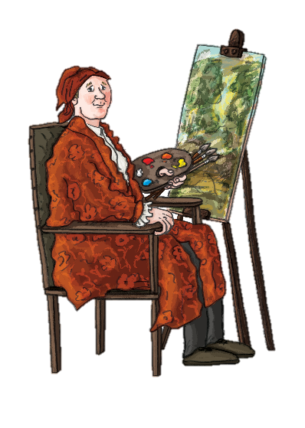
Inspired by artists
Travel writers were enticed to visit the area having seen the picturesque beauty of the Dee Valley depicted in the paintings of famous artists such as Paul Sandby, Richard Wilson and J.M.W Turner.
Richard Wilson
Paul Sandby
J.M.W. Turner

Slide 3
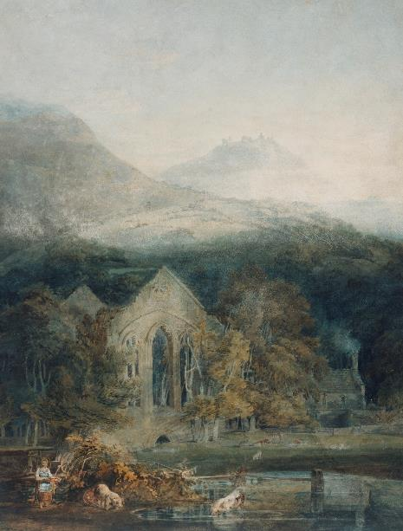
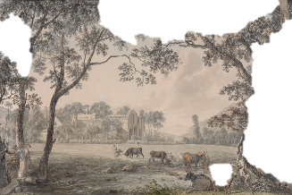
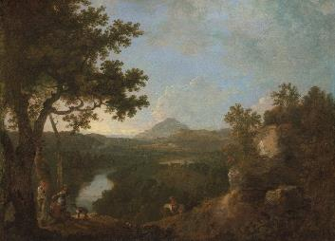


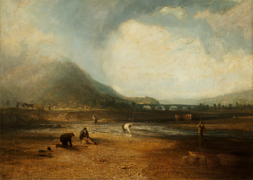
Valle Crucis Abbey, Denbighshire, 1770-79, Paul Sandby. The Metropolitan Museum of Art, New York.
View near Wynnstay, the Seat of Sir Watkin Williams-Wynn, fourth Bt.,1770-71, Richard Wilson. Yale Center for British Art, Paul Mellon Collection.
Valle Crucis Abbey with Dinas Brân, 1794-5, J.M.W. Turner. Photo: Tate.
Paul Sandby
Richard Wilson
Look at these paintings, is there a specific feature that would inspire you to write about the locations?
J.M.W. Turner
J.M.W Turner
The Trout Stream, 1809, J.M.W. Turner. Courtesy of the Taft Museum of Art, Cincinnati, Ohio. Tony Walsh Photography.

Slide 4
Travel Writers
1809
“The approach from Llangollen presents a most delightful scenery of hill and valley, terminated by these lofty pillars supporting their well-turned arches; the whole affords a view of beauty and grandeur, rarely excelled by nature or art.”
When you read these descriptions do you think the Dee Valley has changed over time?
Do you recognise any of the places described?
1862
1838
“Tourists are soon to be seen flying, like birds, from one distant perch to another.”
“Two enormous sheets of flame shot up high into the air from ovens, illuminating special chimneys as high as steeples, also smoky buildings, and grimy figures moving about. There was a clanging of engines, a noise of shovels and a falling of coals truly horrible.”
Oliver Oldschool
1838
Hill and Valley: Or Hours in England and Wales, Catherine Sinclair.
“As from the summit of Dinas Brân I eagerly beheld a succession of the wildest, the sternest and the most lovely landscapes spread below me, I recalled the no less strange and varied fortunes of that lordly castle, now a heap of ruins beneath my feet.”
1802
“Few rides excel the ride from Llangollen to Corwen – the picturesque views of the Dee are justly allowed to be equal, if not superior to any river in Britain.”
Wild Wales: its People, Language and Scenery, George Borrow
John Broster
On wanderings and Excursions in North Wales, Thomas Roscoe.

Slide 5
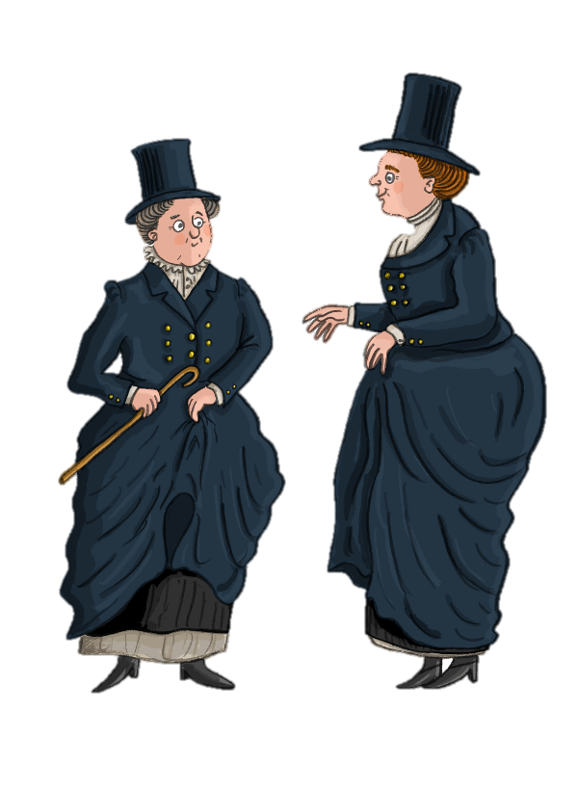
The Ladies of Llangollen
Having escaped from the undesirable lives planned out for them in Ireland in 1778, two ladies travelled together through Wales looking for a place to call home. They decided to live in Llangollen as the Dee Valley suited their desire to live in perfect retirement in the country.
1789
“The sweetest softest silent night. Clouds to the west a gleaming red. We leaned over the gate, admiring the solemnity of the scene and the profound silence which reigned around as if we were the only inhabitants of this Sweet Valley”.
Extract from Eleanor Butler’s Diary – one of the Ladies of Llangollen

Slide 6


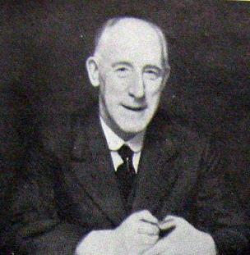
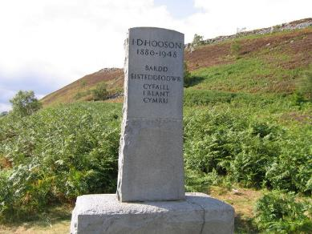
Isaac Hooson
A monument dedicated to Hooson can be found on the Panorama Walk above the Vale of Llangollen.
Isaac Daniel Hooson (1880-1948) was a poet who lived in Rhosllannerchrugog. By the time of his death, he was known for his generous commitment to both the National Eisteddfod and Urdd Eisteddfod.
I.D. Hooson

Slide 7
From Hooson’s poems we can surmise that he cared deeply for nature, this is one of the many wildlife themed poems he wrote...
The Hare
On the plains behold the greyhound
After her with her agile long stride,
she leaps up the slopes of the hill;
Keep going, brown of your colour!
Through the gorse, past the scrub,
Through the heather the trail runs;
Past the wall where she was for hours
Last night under the moonlight.
Today there is no place anywhere
To her, poor fugitive,
But the last irreversible border;
She knows that death is upon her.
Long leap again, nimble long leap -
(There’s a Flash that is sure of her!)
Long leap again, and the elongated ears
In its tight grip as a corpse.
Dog barking and loud shouting,
More which won’t tire the brown hare;
In case it frightens her ever more from her stride
On the moors like a flame.
Elongated ears, shining eyes -
There she is, the gay hare;
Distant barking and a sudden leap,
Away she goes through the green like a flame.
Look at her crossing the land -
Two short legs, two long legs -
There’s the Flash, of the fine greyhound,
After her through the heather and brambles.
She goes on without deviation,
On her way fast, fast;
Wild eyes, tall ears,
And four long legs trying to catch her.
Through the heather and damp grass,
Her speckled jacket is glittering;
And beneath it the small heart
Beating quickly this morning.

Slide 8


Think
Does the description of the countryside in Hooson’s poem still sound like the Dee Valley area today?
Do you think we still have hares in our local countryside today?
Can you deduce anything written in the in the poem that has changed in the 100 years since Hooson wrote it?
The following activities were developed by poet and author Sian Northey…

Slide 9


This activity has been created as an out and about session.
Choose a picturesque site within walking distance of your classroom, such as Castell Dinas Bran, Pen-y-Pigyn, Llangollen canal, Chirk Aqueduct.
Activity 1:
Create a descriptive piece of writing inspired by a place
You will need:
Paper
Pencils
Clipboards
A3 paper
Marker pen
Sit mats

Slide 10
Instructions – Descriptive Place
In school ask the pupils to write in the first person describing any physical act e.g. playing football, cleaning the house, dancing. Ask them to focus on exactly what their body is doing. (5 - 10 minutes)
Using their writing, create a list of all the verbs they have written. Many of them will be verbs relating to movement e.g. push, stretch, trip, run and there will be others e.g. sweating, resting, contemplating.
Now taking their lists and go for a walk to a picturesque site in the Dee Valley e.g. Castell Dinas Bran, Pen-y-Pigyn or Chirk Aqueduct. On site ask the pupils to create a class list of nouns - things to see from and at the picturesque location. Write this on the A3 paper and place it visible for everyone.
Now as individuals, use their own list of verbs and the class list of nouns create a piece of descriptive writing about what can be seen from or at the location. Emphasise that there is no "right answer" – only they know whether the river they saw (though it is exactly the same river as everyone else saw) was laughing or sidestepping or jogging. This activity can take approximately 15 minutes.
Possible variation: A "group poem" can also be created with the teacher encouraging ideas from everyone verbally and writing on behalf of the group.

Slide 11
Instructions –
Activity 2:
Write a short story inspired by a place
You will need:
Pieces of paper
Paper
Pencils
Clipboards
Sit mats
Ask the pupils to consider the following situation, and try to see it as alive as possible in their minds:
You have walked to Dinas Bran Castle. You are on your own or you have strayed from your friends or family. You walk past the corner of one of the walls at the summit and see...
At this point give everyone a piece of paper with the various words on it e.g. BABY, TOY TRAIN, LARGE BOX FULL OF LEGO.
Their task is to continue the story from that point on. They can make a start whilst you are together at the location and then continue their writing back at school.

Slide 12
Baby
Box of lego
Fur coat
Lady in a
wheelchair
Hot water bottle
A table set with crockery
Frog
Hymn book
Toy train
Kite
Phone charger
Glasses
Candles and flowers
A framed photo
Hot mug of coffee

Slide 13

Instructions –
This activity has been created as an out and about session. Choose a picturesque site in walking distance of your classroom, you could be based at Castell Dinas Bran, Valle Crucis Abbey, Chirk Aqueduct etc.
Give each pupil a picture frame. Ask them to go to any part of the site which appeals to them and place the frame on any surface (e.g. floor, stone wall, tree).
The task is to describe what is within the frame, and only within the frame. They need to keep looking and describing for several minutes, over this time more and more things will come to light.
For example: There is grass. And the grass in the top corner is different, seeds haven’t developed yet. And there is a small fly walking across the grass… Reiterate that there is always something else to see if you keep looking.
Once complete, ask the pupils to share what they have written and to discuss the task of looking so closely at one small piece of the world for a prolonged time.
Activity 3:
Writing inspired by the small things
You will need:
Picture frame or card viewfinder
Paper
Pencils
Clipboards
Sit mats

