Slide 1

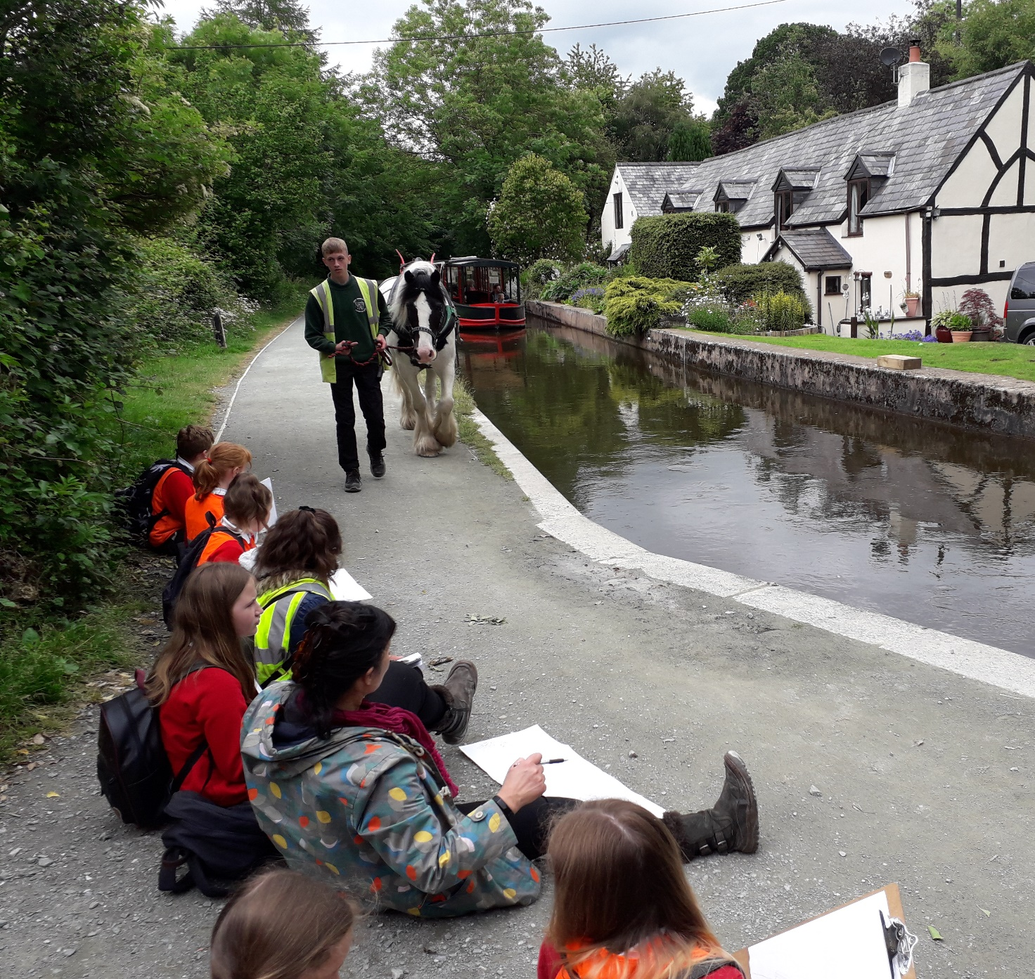

Wild Art
Out and About

Slide 2

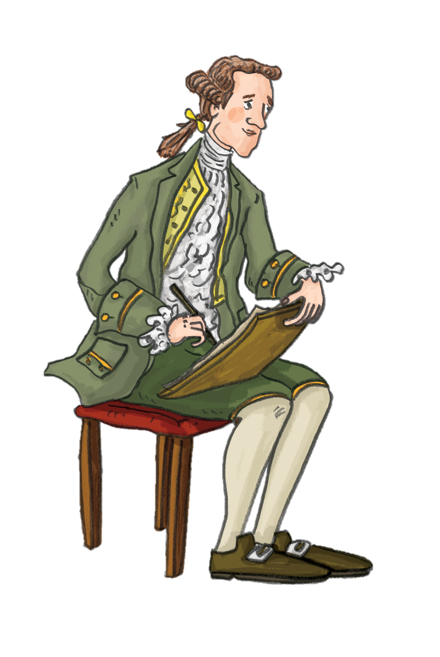
Wild Art Activities
These Wild Art activities are an opportunity to collect sketches and memories of a landscape/location.
The pieces can be further developed back at school where more resources are available, the same approach as the 18th Century artists had themselves.
Pupils will be following in the footsteps of the artists that visited and recorded the landscapes of the Dee Valley in the 18th Century.
You will find more resources about these artists in The Dee Valley People Learning Bundle and Travel and Tourism in the Dee Valley learning bundle on the Pontcysyllte WHS website.
The following activities are predominantly outdoor nature art activities, you can do them in the school grounds or out and about on a walk in your local area. You may wish to bring foam mats to sit on whilst outside.

Slide 3

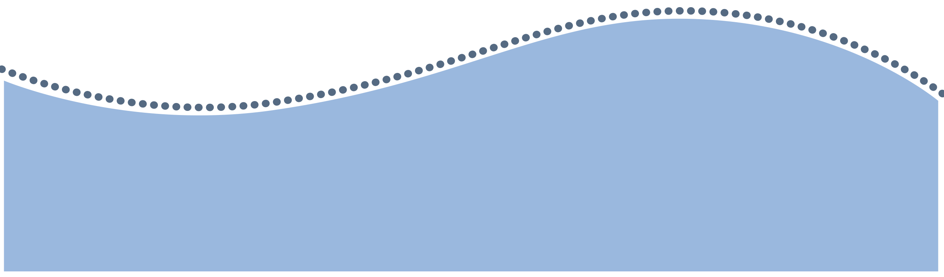
This activity works best alongside a body of water like a canal, river or a large pond.
You will need safe access to the waters’ edge or a tray of water which you can easily replenish from the natural water course.
Activity 1:
Drawing with Water
You will need:
White paper
Clip boards
Pencils
Black berol felt tip pens
Paint brushes
String
Clothes pegs

Slide 4
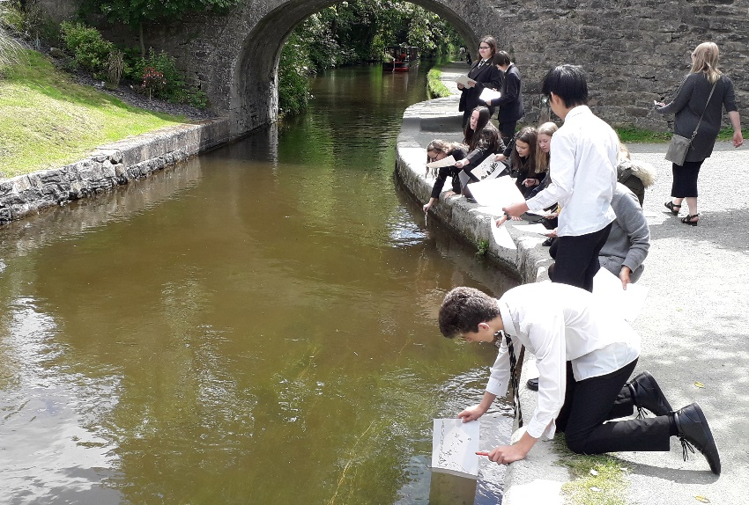
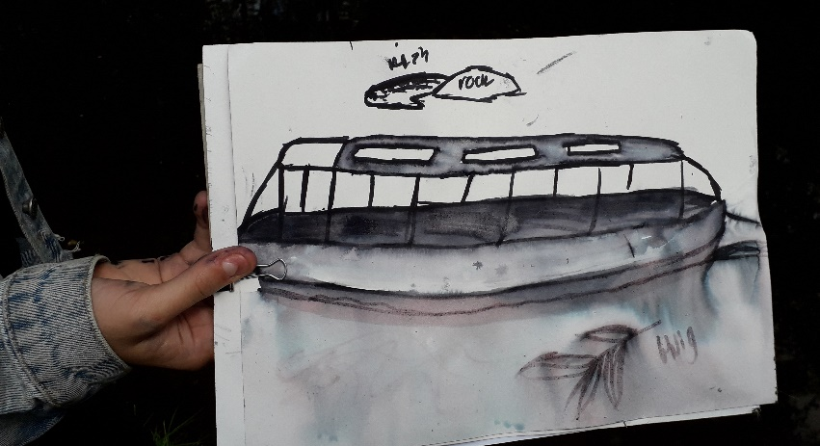
Instructions – Drawing with water
Start off near the water and discuss what they can see: shapes, patterns, plants, animals etc.
Ask each child to draw in washable felt tip pen the river or canal. Draw what is in the water and floating on it, what is found below the water or around it. Encourage them to concentrate on the water specifically.
Set up a washing line to dry the drawings on.
Once the drawings are completed, pupils can write their name in pencil and return the clip board.
Dip their entire drawing gently but swiftly onto the surface of the water or add water in specific areas using a paintbrush. Encourage them to experiment to create different ways to represent the water in their picture.

Slide 5


Activity 2:
Sound maps, network drawing and collecting colours
You will need:
White paper (A4 and A6)
Clip boards
Pencils
Card with a short piece (up to 5cm) of double sided tape attached.
Each pupil needs to choose to sit where they can look closely at the environment as if zoomed in with a lens.
These are connected, mindful and focussed activities.

Slide 6
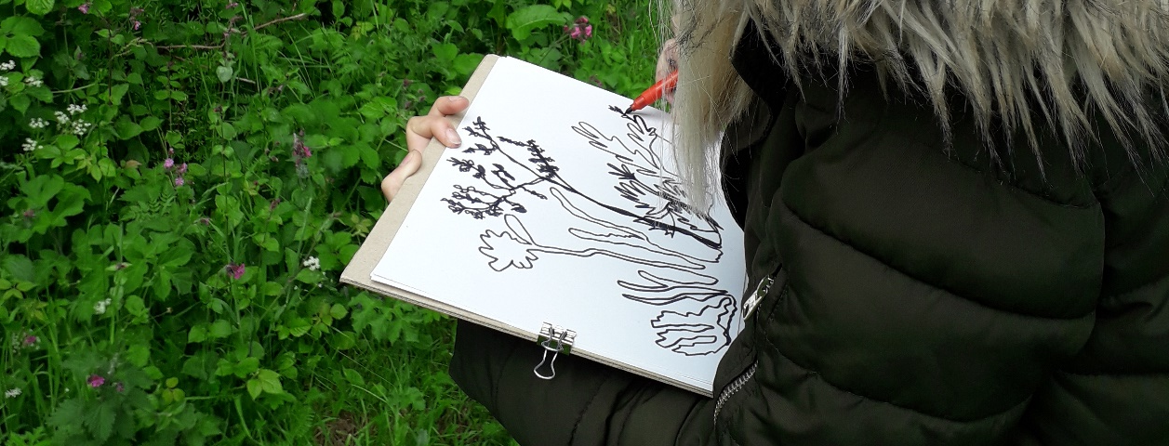
Instructions –
Sound maps, network drawing and collecting colours
Collecting Colours – Hand out the card with double sided tape. Staying at the same spot, the pupils will collect the colours directly in that area. Encourage them to only take tiny parts of the leaves, single petals (not whole flowers), small scrapes of bark, a dab of the flower pollen directly onto the card, therefore minimising the damage/impact to the plants. They will stick these onto their double sided tape. Encourage them to look for different shades of the same colour.
Sound Maps – The pupils will need piece of paper (A6). Closing their eyes and sitting quietly, they will listen to the sounds in the environment around them and record these sounds by drawing symbols on the paper. For example: a wavy line could represent the wind, a zigzag could be a dog bark, a spiral could be bird song. Give the pupils 5 minutes to do this.
Network Drawing – Staying in the same spot, the challenge is to draw without taking the pencil off of the paper (A4). The pupils will draw the vegetation all in one continuous line, there is no right or wrong way to do this, they just need to keep the pencil in contact with the paper. They can vary the speed they draw. Give them a set time and a warning as the end approaches.

Slide 7
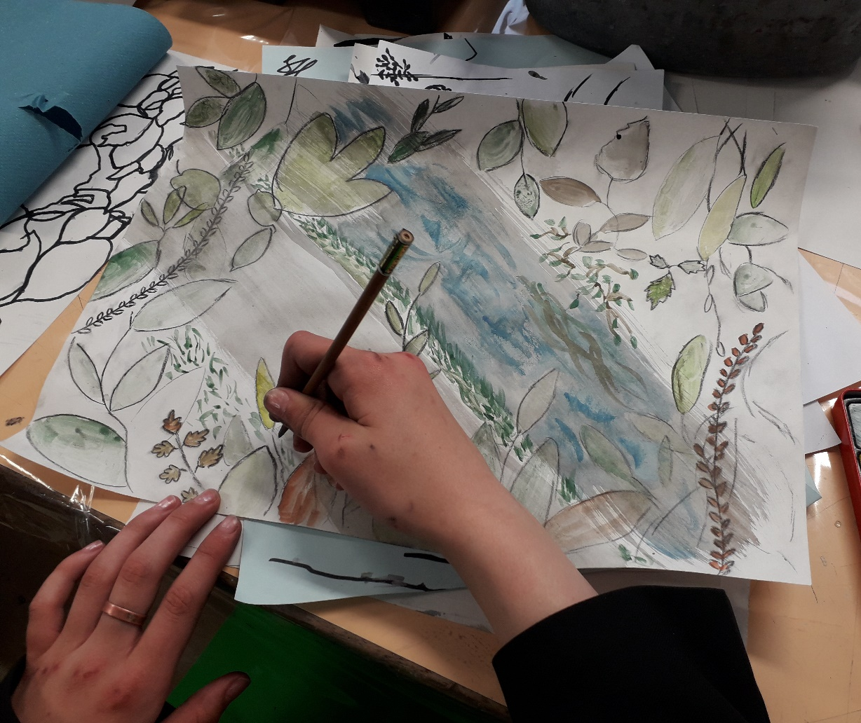
Instructions –
Sound maps, network drawing and collecting colours
Back in school you will need colouring materials that can be mixed and blended eg. watercolour paints, pencils, pastels.
The pupils will use their collected colours to help them colour parts of their network drawing. They can also incorporate their sound map symbols within the main piece of art.
Reflection: Make a miniature art gallery.
Consider the similarities and differences between the different pieces of art. Are there different habitats represented and can you tell what kind of habitat or vegetation it is?

Slide 8
Instructions –
Activity 3:
Shadow Art
You will need:
A sunny day
White paper
Clipboards
Pencils
Charcoal
Vegetation
Ask the pupils to locate an area where the vegetation is easily accessible (the edge of a meadow, hedgerow, or below tree branches). Ideally leave the vegetation attached and growing rather than picking it.
The pupils will carefully draw the shadows created by the vegetation on their paper. They don’t need to draw every part of the shadow and can experiment with overlapping different shadows. Encourage them to try different individual plants and habitat areas.
These shadow sketches can be used on the imaginary collaged landscapes activity back at school.

Slide 9

Activity 4:
Viewfinders
You will need:
Strips of card stuck together with tape to create a small rectangular window viewfinder
Pencils, charcoal, white chalk
White or black paper
Clipboards
JMW Turner’s sketches of the Dee Valley
Many artists use viewfinders to help focus on an aspect of a view that they wish to sketch.
It is a simple technique, however over the centuries artists have used other more complicated techniques such as Claude Glass and the Camera Obscura.
You can find out more about these in the Exploring the Dee Valley Learning Bundle.

Slide 10
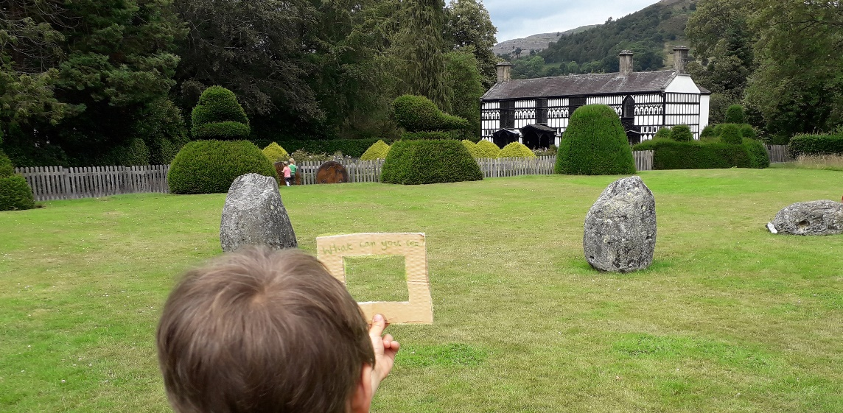
Instructions – Viewfinders
Go for a walk and ask pupils to look for a view that they would like to sketch. They will use their viewfinder to focus their attention on one area of the wider landscape view, by holding it out at arm’s length, looking through the window and sketching what they see.
You can show them the simplicity of the sketches that JMW Turner created on his tours of North Wales. Encourage them to sketch shapes and patterns to build up their scenery rather than drawing specific features such as trees or buildings.
Pupils can draw two versions of the same view or different views using the coloured papers and drawing materials.
Back at school (as a class or in smaller groups) the pupils can arrange their pieces to see if they can create a whole landscape view. Experiment with different orders and extend their drawn lines to meet the horizons in another piece. Then they can tape the papers together to make a larger landscape scene.

Slide 11
Activity 5:
Collaged Landscape
You will need:
Dead twigs
Old vegetation (dried seed heads, dry fallen leaves)
Tracing paper
A3 and A4 white paper
Crayons, pastels, pencils, paint
Scissors and glue
Sketches from the shadow art and drawing with water activities
This activity links well to the Our Special Landscape Learning Bundle and works well as a culmination of the above activities especially if they have taken place outside of the school grounds.
This activity involves collecting resources outside but mostly takes place in the classroom.

Slide 12
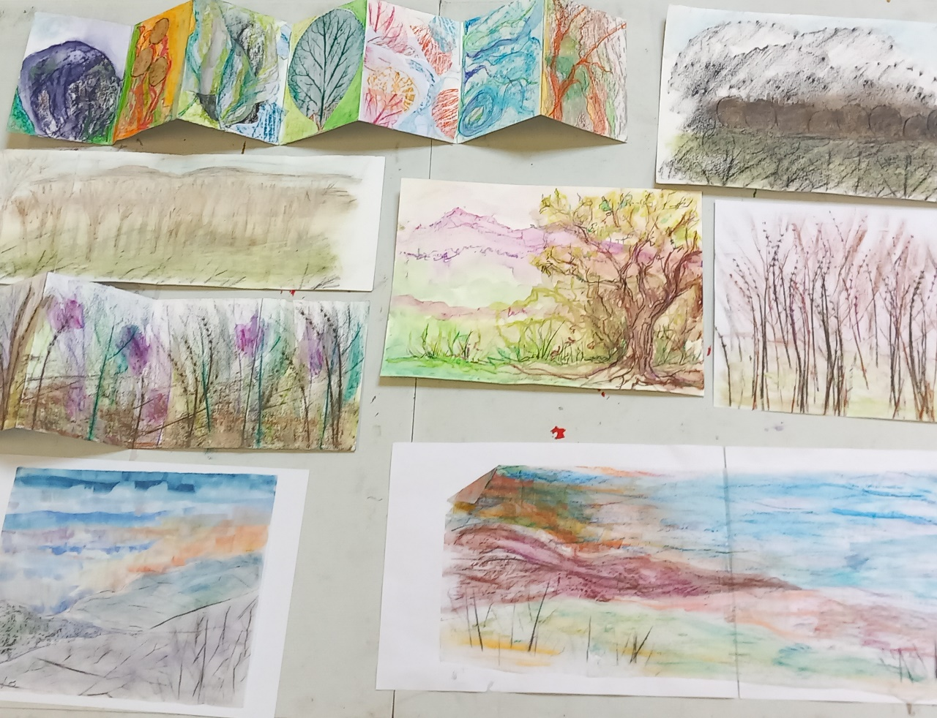
Instructions – Collaged Landscapes
Encourage the pupils to experiment with the resources, to cut out and collage and include parts of their sketches to create their own imaginary landscape.
They can do leaf rubbings and tracings, use the twigs to create shadows to draw their horizons for their landscape and shadows of the seed heads as trees.
Reflection: make a mini art gallery and in pairs each pupils can give a guided tour of their collaged landscape explaining the landscape features and the ways they created them.

