Slide 1



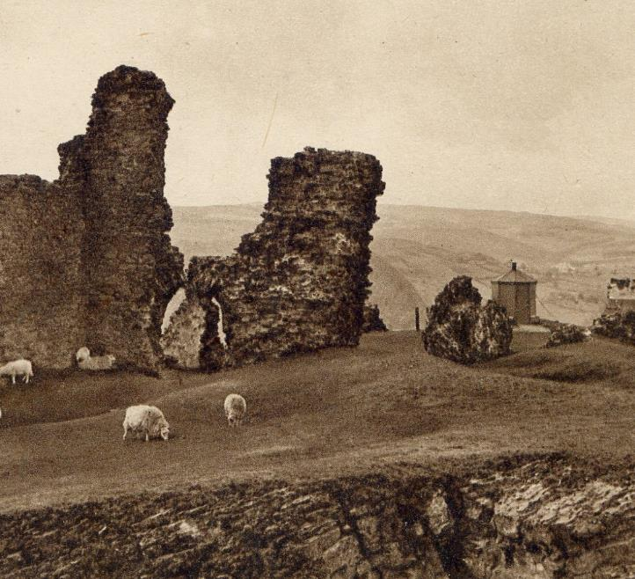


Camera Obscura
and Pinhole Cameras
The Dee Valley was once home to a marvellous piece of Victorian engineering known as a camera obscura.
These structures were the height of entertainment in the 1800s and helped to develop the modern camera!

Slide 2
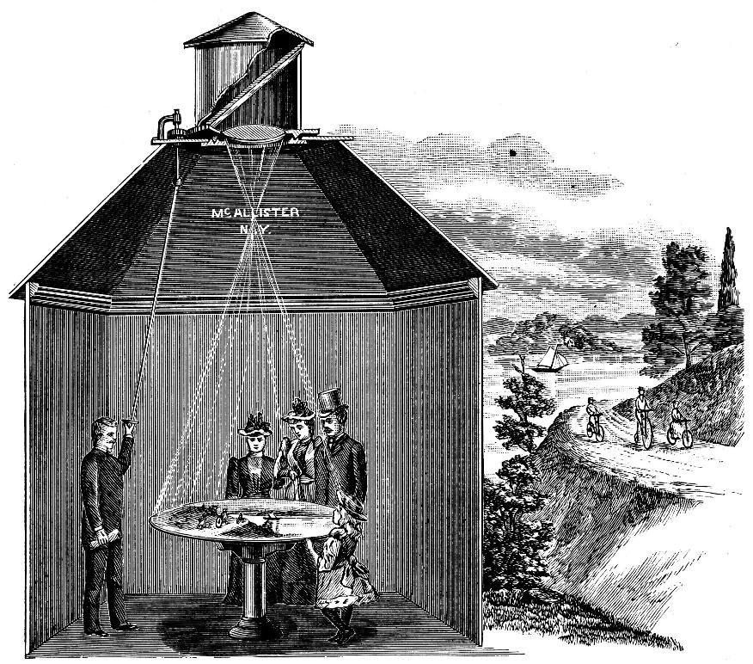
What is a camera obscura?
The camera obscura is an ancient optical device. The name comes from the Latin words for 'dark' (obscura) and 'room' (camera).
With a camera obscura, you can perfectly capture the world around you by projecting what's on the outside, into a darkened space on the inside.

Slide 3

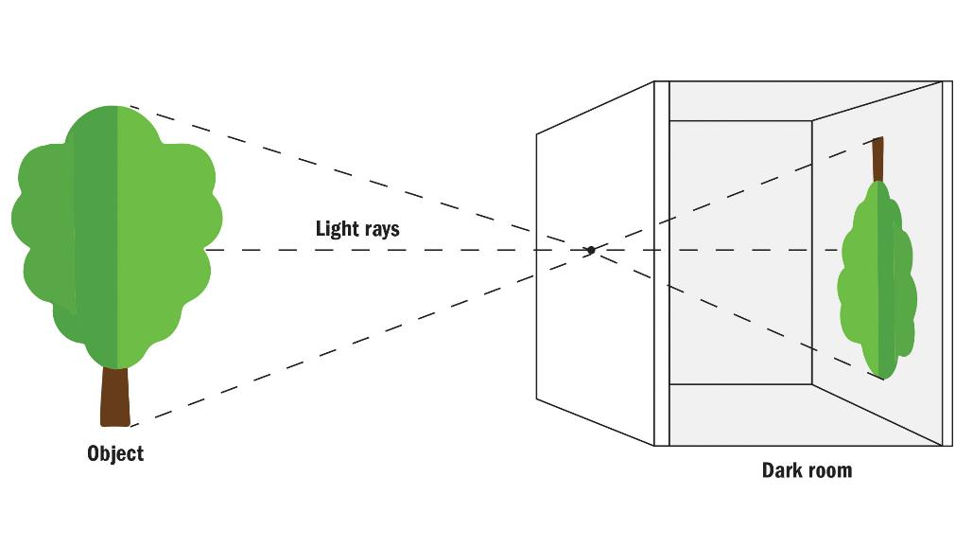
How does it work?
In its simplest form, a camera obscura is a dark room with a small hole in one wall. When it’s bright outside, light enters through the hole and projects an image of the outside world onto the wall opposite the hole. This image is upside-down and back to front.
A small hole produces a sharp, dim image, while a larger hole produces a brighter picture which is less well focused.
Light rays
Object
Dark room
Notes:
A camera obscura flips an image because light travels in a straight line through a small hole into a dark space and strikes a surface. This causes the image to appear upside down and reversed (left to right) on the surface opposite the hole. For example, light from the top of an object will reach the bottom of the camera screen, and light from the bottom of the object will reach the top of the screen.

Slide 4
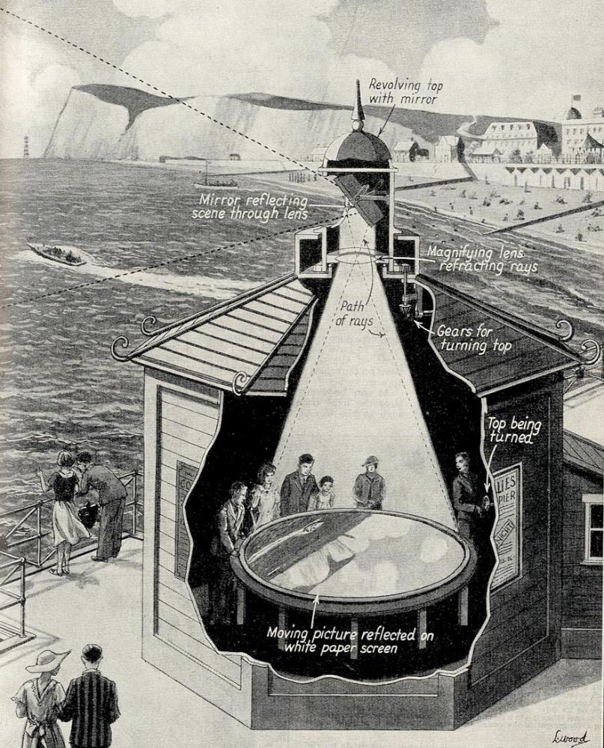

The invention
The earliest official references were recorded by Alhazen, an Arabic scholar in about 1030 AD. He is said to have invented the camera obscura as well as the pinhole camera (based on the same idea).
By the 1550s, optical lenses were used to enhance the brightness and sharpness of the projected image.

Slide 5

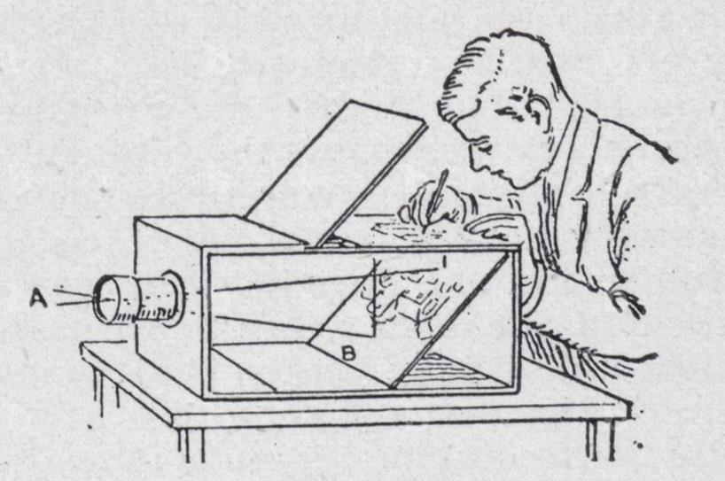
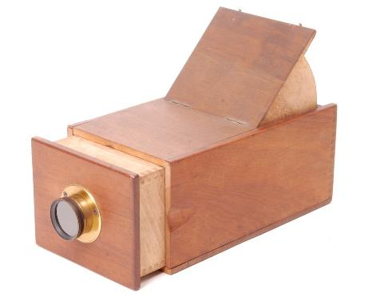
Portable camera obscura
In the 17th century, portable versions were widely used by artists as aids to drawing. Painters would once have used a camera obscura like this for making accurate, detailed sketches of scenes - like landscapes or architecture.
"There on the paper you will see the whole view as it really is, with its distances, its colours and shadows and motion, the clouds, the water twinkling, the birds flying. By holding the paper steady, you can trace the whole perspective with a pen.“
Daniele Barbaro, 1568

Slide 6
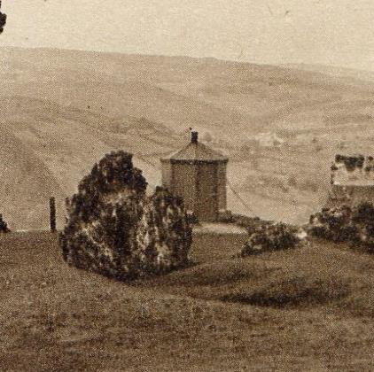
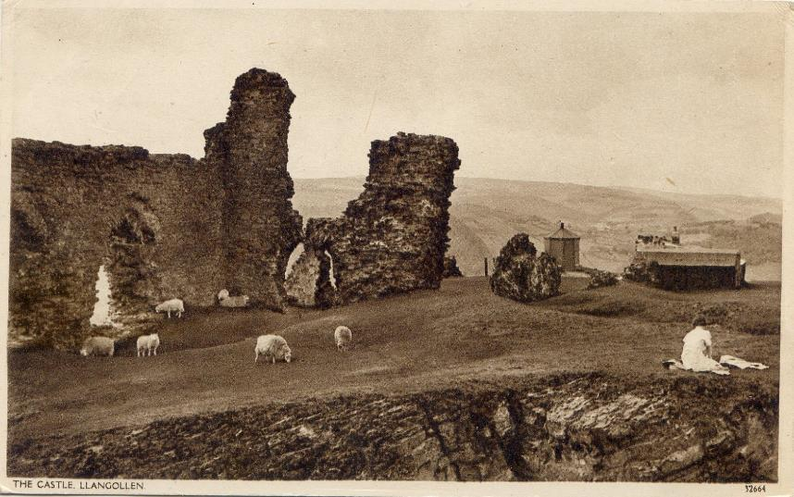

Camera obscura on the Castle!
During Victorian times, larger camera obscuras reached their pinnacle of popularity. Many were built at seaside and tourist resorts, allowing groups of people to experience the phenomenon together. The live images were a great source of entertainment.
In 1869, Llangollen had its own camera obscura at Castell Dinas Brân, showcasing the outstanding views of the Dee Valley until World War II.

Slide 7
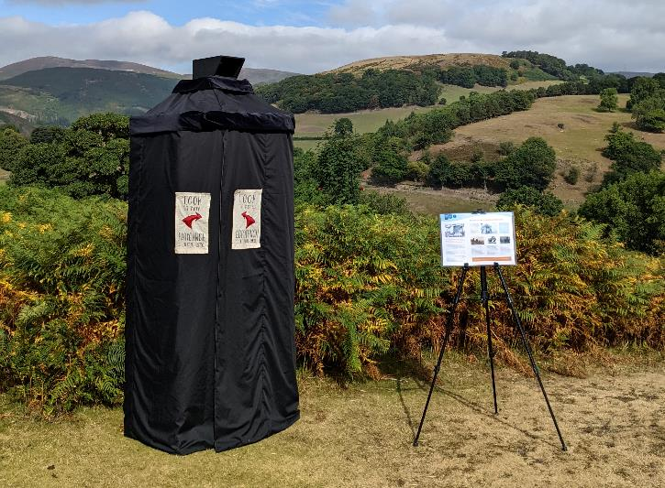
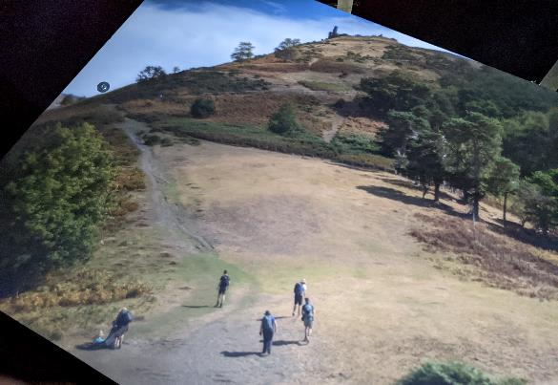
Camera obscuras today
Today, there are still ten Camera Obscuras open to the public across the UK and many others around the world!
Want a go?
You can arrange for a
portable camera obscura to visit your school for free. Contact the National Landscape ranger team for more details.

Slide 8

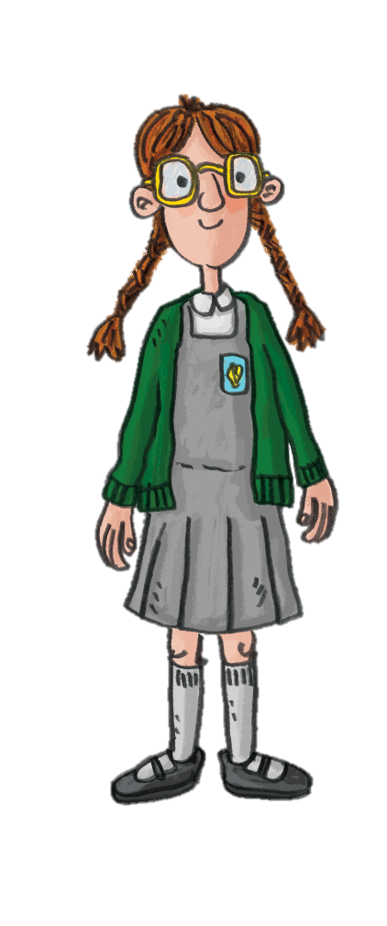

Watch
Llangollen: A Time Travel Adventure
Task
Watch the Llangollen: A Time Travel Adventure video.
Note down some of the interesting facts and special features about the camera obscura in Llangollen.
Make a poster to advertise the camera obscura to visitors.

Slide 9

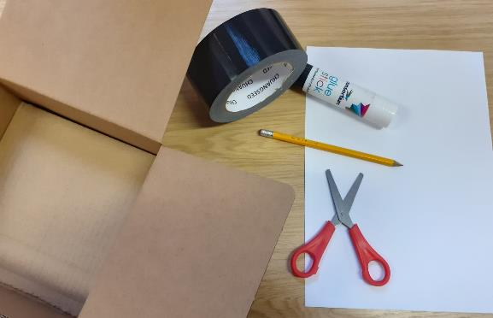
Using the basic principles of the camera obscura
Make your own Pinhole Camera!
You will need:
A cardboard box that can be closed, e.g a shoebox (it is easier to make and use if the box is at least 20cm wide)
Black duct tape
Sheet of white paper
Glue stick or double sided tape
Scissors
Pen or sharp pencil

Slide 10
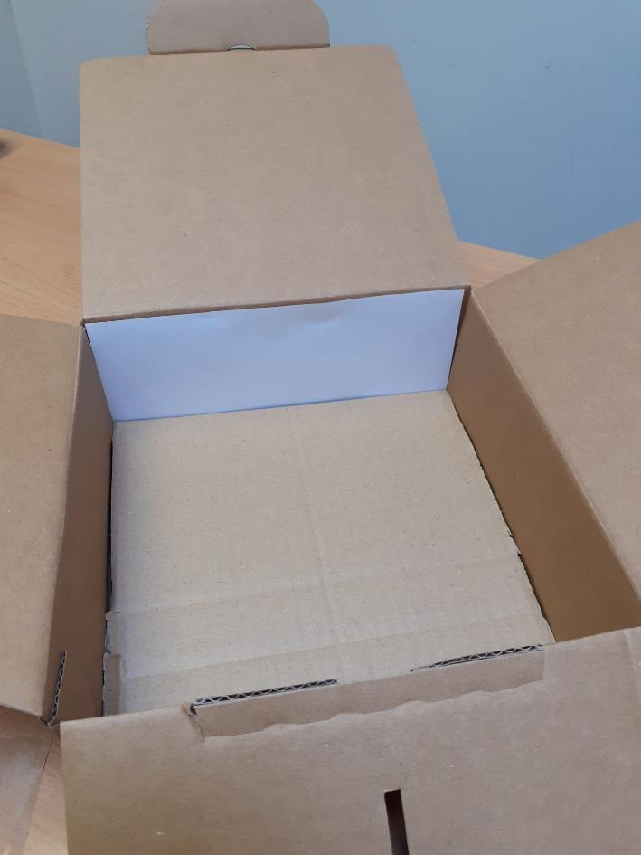
Step 1 – Make the screen
Cut the piece of white paper to fit one side of your box. Use the glue or double sided tape to stick the screen on the inside of your box.
Tip
If the box is rectangular, put the screen on one of the shorter sides.

Slide 11
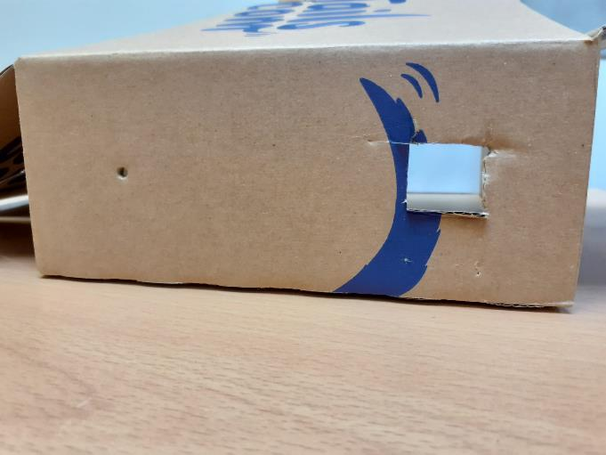
Step 2 – Make some holes
You need to make two holes in the side of the box directly opposite your screen.
The first hole is your viewing hole. Cut a small square out of the box, big enough to be able to see through into the box, but not so big it lets too much light in.
The second hole is the important pinhole. Use the pen or sharp pencil to poke a small hole into the box.
Tip
These holes should be far
enough apart so that when you look through the viewing hole your head doesn’t block the pinhole.

Slide 12
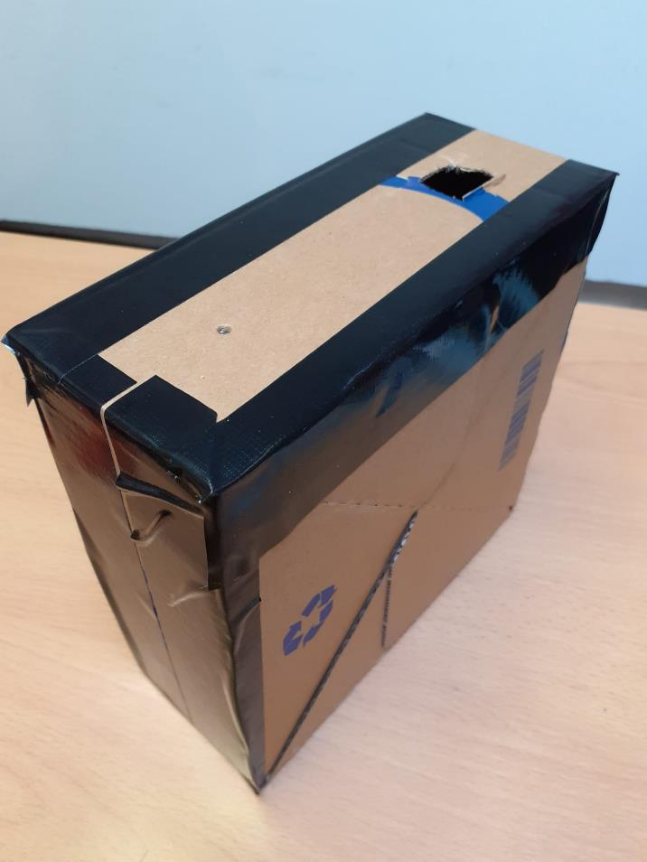
Step 3 – Seal the box
Close the box and use the black tape to seal any gaps where light might get in. Only the holes you have made should stay uncovered.
Tip
Check through your viewing hole to make sure there is no light getting in through the corners or edges.

Slide 13
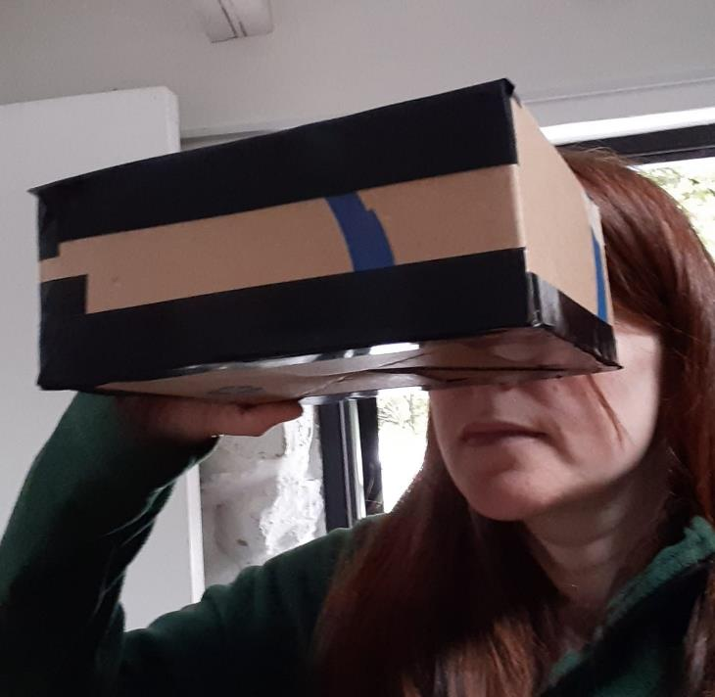
Step 4 – Use your pin hole camera!
Stand with your back to the space you want to view. Look through the viewing hole, making sure your head isn’t blocking the pinhole. You should be able to see the view projected upside-down onto your screen!
Tip
This works best if you stand in a dark room and point the pinhole toward a bright subject, e.g. stand in a room with the lights off and point the pinhole towards a window.

Slide 14



Top Tips
If you’re having trouble seeing the image, try moving around and tilting the box up and down and side to side until you find it.
If the image is very dark, you can try making your pinhole slightly larger.
You could even try making a hood, like they used on old fashioned cameras. Put a blanket over your head the box, making sure to leave the pinhole uncovered.

