Slide 1
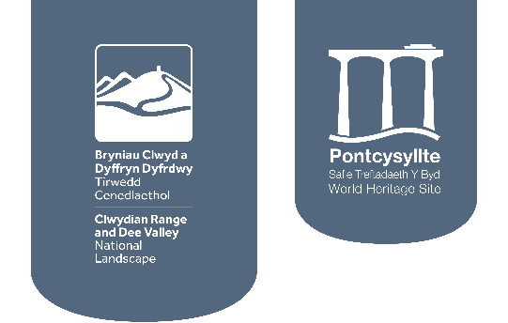
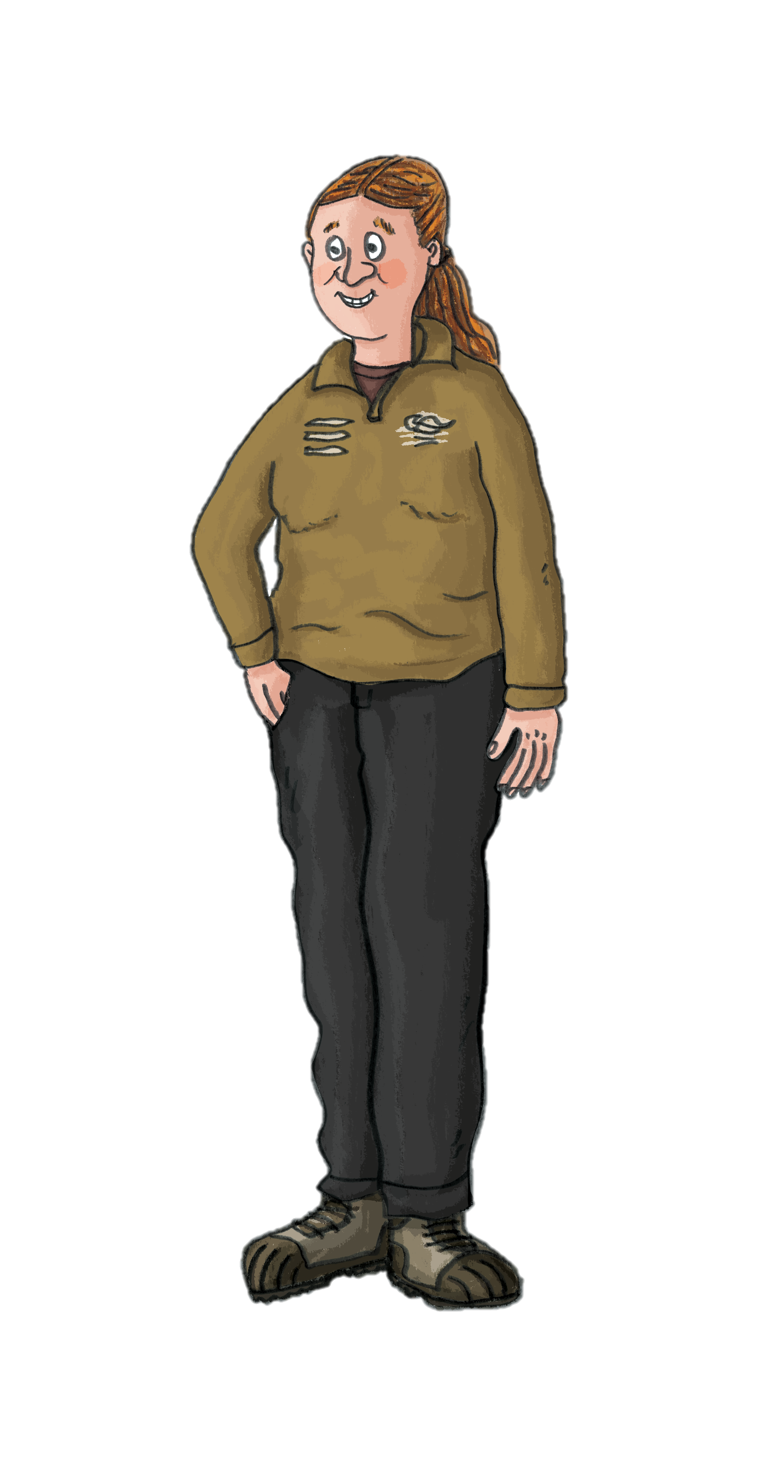

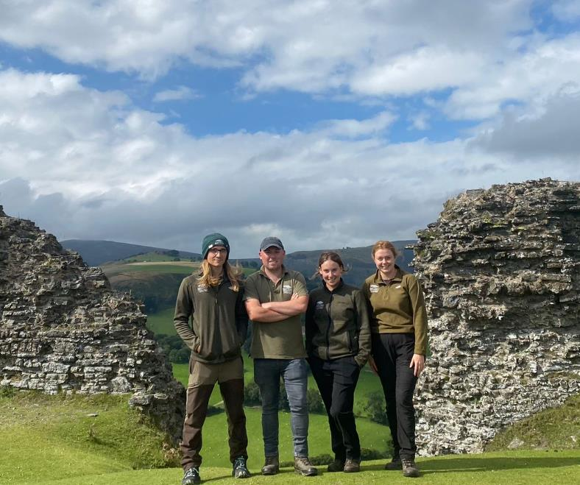
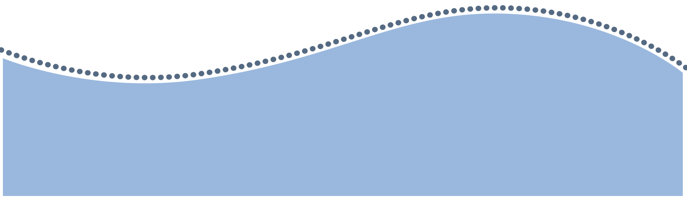
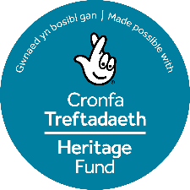
Character Fact Sheets
Custodians of the Dee Valley
Let’s find out about some of the important people who work to protect the Dee Valley today.

Slide 2
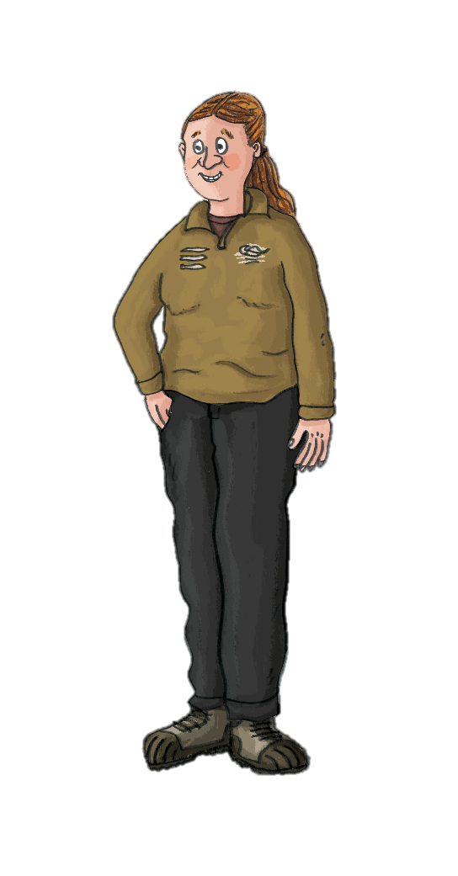


Character Fact Sheet
Countryside Ranger
A day in the life
During the winter most of my tasks are habitat management based, whether this is coppicing in woodlands or clearing small trees and shrubs from our heathland sites. During the summer, the tasks become more varied and range from footpath maintenance and way marking to drystone walling and other traditional skills such as lime mortaring and charcoal making. Another big part of my job is engaging with visitors, whether that be day to day out on site, leading volunteers or at organised events such as guided walks. My favourite guided walk to lead is looking for nightjars on Moel Famau.
[
[
[
[
I’m Dwynwen, a Countryside Ranger. My job involves managing green spaces that are open to the public, whilst also protecting plant and animal life.
Favourite Dee Valley site:
My Favourite site is Castell Dinas Brân as it is always so peaceful. I enjoy being surrounded by its rich history.
There is nothing more disheartening than having to clear up after people that don’t take their rubbish away with them, be it a plastic bottle, crisp packets or dog poo bags.
The most satisfying thing is finishing a task and looking back at what you have achieved and how much of a positive impact you have made to the landscape and community.
Favourite view:
Watching the swifts nest at Chirk Aqueduct and Viaduct.

Slide 3
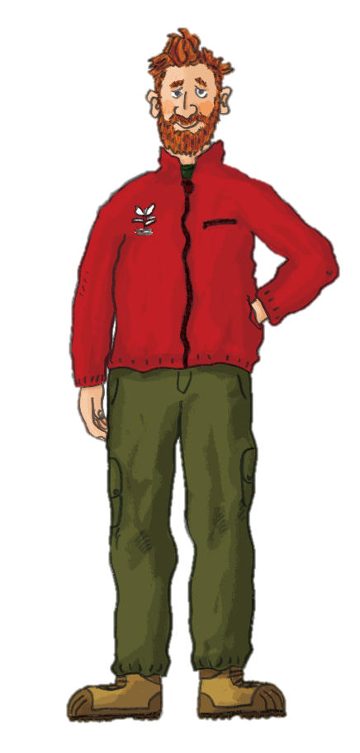

Character Fact Sheet
Heritage Assistant
A day in the life
There is always a vast range of tasks to complete during my day at work. We give guided tours, take group bookings, answer any queries and make sure the carvings and stained glass are perfectly dusted and shining bright!
I begin the day by waking up the house; opening the shutters and making sure everything is in perfect condition
for our first visitors. We take care of and monitor the
conditions of the collection of historic artefacts inside the house and spend time researching the history of the famous residents to share with visitors.
[
[
[
[
I’m Garth, a Heritage Assistant at Plas Newydd Historic House. My job is to tell visitors about the Ladies of Llangollen and the history of their extraordinary home.
Favourite Dee Valley site:
I love Pen-y-Coed woods in Llangollen as it was a favourite walking spot of Eleanor Butler and Sarah Ponsonby.
A downside to working in a busy site is managing car parking for visitors. I would love to recommend walking or cycling to the site, reducing the pollution and keeping the grounds as natural as possible.
I love being a local source of knowledge to visitors and can educate and spread the story of the Ladies of Llangollen to people all over the world.
Favourite view:
Peering through the Dell at Plas Newydd on an autumn afternoon.

Slide 4
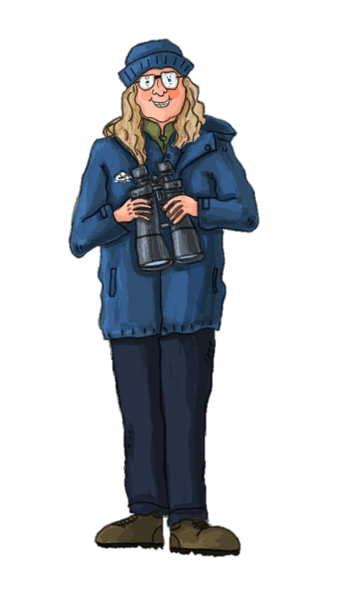
Character Fact Sheet
Dark Sky Officer
A day in the life
It’s my job to make sure people know how important our dark skies are and that we are doing everything we can to protect them. During my day I give lighting guidance to community councils, look over planning requests and organise events. I regularly get asked to do presentations to clubs and societies. Then I might go to check the lights at a property and make sure they’re not negatively affecting any of our nocturnal species like bats and owls. Most evenings you’ll find me out and about running stargazing events to share knowledge and culture of the stars.
[
[
[
[
I am Dani and I protect the darkness! The Dee Valley is fortunate to have wonderful dark skies, it’s somewhere you can come to stargaze with little interruption from light pollution.
Favourite Dee Valley site:
I don’t look forward to reports of seabirds stranding because of bright lights or finding examples of where bad lighting has trapped bats inside their roosts.
I love to teach people about the magic of our dark skies and how darkness is so important for our health, wellbeing and wildlife.
My favourite site is the scenic Horseshoe Falls, as it is one of our local dark sky discovery sites.
Favourite view:
Caer Drewyn hill fort in August during the Perseids meteor shower.

Slide 5
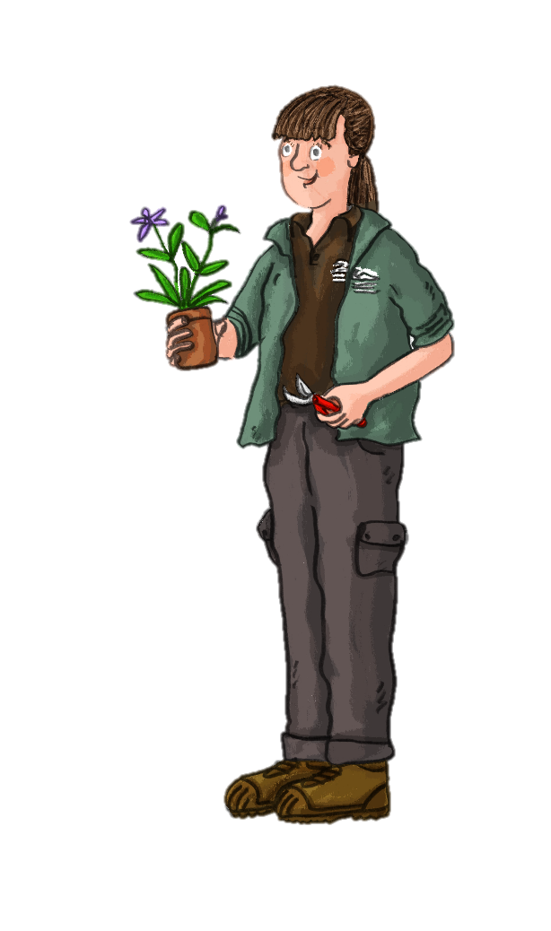
Character Fact Sheet
Volunteer
A day in the life
Every Wednesday I like to volunteer at the Community Garden. The space is cared for by volunteers and there are always plenty of tasks to last the whole year! In the spring we prepare the beds for planting vegetables, herbs and flowers. By summer, the garden is flourishing with colour and wildlife. We water the plants, prune the trees and pick the harvest from the fruit and vegetable plants. Our hard work increases access to free, fresh and local food for local people. We then sit down as a group to enjoy a hot drink and biscuits, it’s a great way to connect with new people and learn new skills.
[
[
[
[
I’m Carys and I volunteer at Corwen Community Garden. I help to maintain and care for the garden so that local people can enjoy it!
Favourite Dee Valley site:
My favourite site is Pen-y-Pigyn as I am enchanted by the stories of the Corwen Giant.
It is upsetting when the garden is vandalised as the volunteers put so much time and hard work into looking after the garden.
I love that the plants we grow help to improve the local ecosystem, and provide habitat for pollinators like bees and butterflies.
Favourite view:
Looking out at the River Dee on the steam train from Corwen to Llangollen.

Slide 6
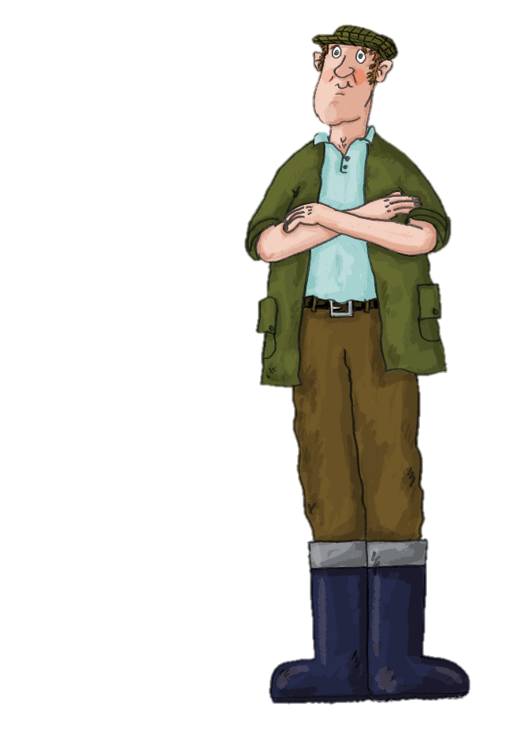
Character Fact Sheet
Farmer
A day in the life
Each day I wake up early to feed my flock of Welsh Mountain sheep. I do my daily checks which include making sure the livestock look healthy and have no injuries and that the fencing is all intact. As a custodian of the land, I work hard to maintain habitats for native plants and animals, protect watercourses and support wildlife species. I'll be trimming the hedges and mending fences, hanging gates or using traditional skills to repair drystone walls. Sometimes I need to round up the sheep for shearing or move them to a new field with the help from my trusty sheepdog. At the end of the day I like to think how lucky I am to work in the great outdoors in such a beautiful area.
[
[
[
[
I am Bryn and I live and work on a farm in the Dee Valley. I have a responsibility to look after the animals on my farm as well as care for the land.
Favourite Dee Valley site:
My favourite site is Llantysilio Mountain where my sheep roam the hillside to graze.
Recently, the weather has been more and more extreme with an increase in flooding and fires on the farm.
The best part of my job is having a goal and working towards it, whether that’s improving the biodiversity of my land or cutting out pesticides.
Favourite view:
The purple heather moors on the Horseshoe Pass.

Slide 7

Reflection
Activity
Read the character fact sheets and create a spider diagram or mood board for one of the different job roles.
You may wish to…
Draw your character and the tools they need for their job.
List their key daily tasks.
Add images of their work using internet searches.
Describe what they dislike about the job and offer three solutions.
Locate their favourite site on a map and add a fact and photo of it.
Find an image of their favourite view.
If you could work to protect the Dee Valley, which job role would suit your skills?
How would you would feel after a day protecting the landscape and who would benefit from your work?

